Slide 1
BigData Spark Hands-On 5 Spark Java
Esilv 2024
arnaud.nauwynck@gmail.com

Slide 2
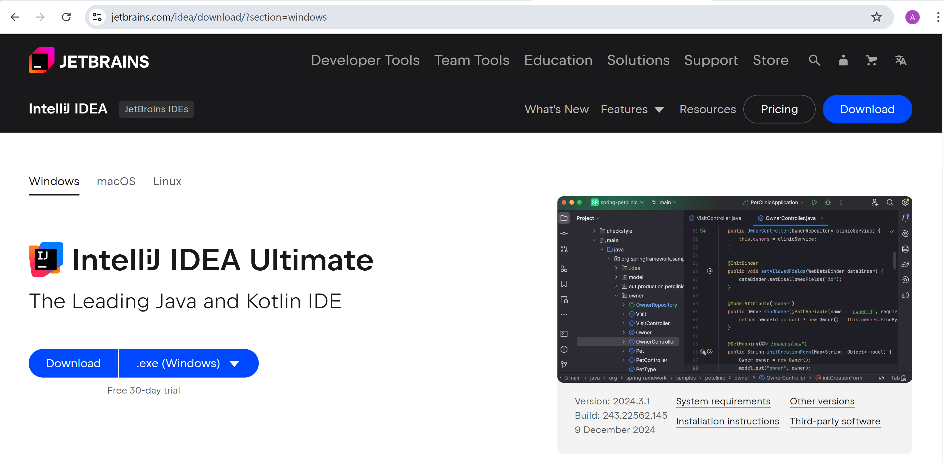
Pre-Requisite : Install Java IDE (IDEA IntelliJ)
https://www.jetbrains.com/idea/download

Slide 3
Note : pre-requisites
IntelliJ IDEA "Community" Edition is Free (but supports only Java/Kotlin langage)
you can also choose "IntelliJ IDEA Ultimate" Edition
free for students => register an account with your "@esilv" email
for doing the TD only => you have free 30 days-trial without registering

Slide 4


Steps to get IntelliJ IDEA "Ultimate" Edition

Slide 5


Steps ...
@ esilv

Slide 6
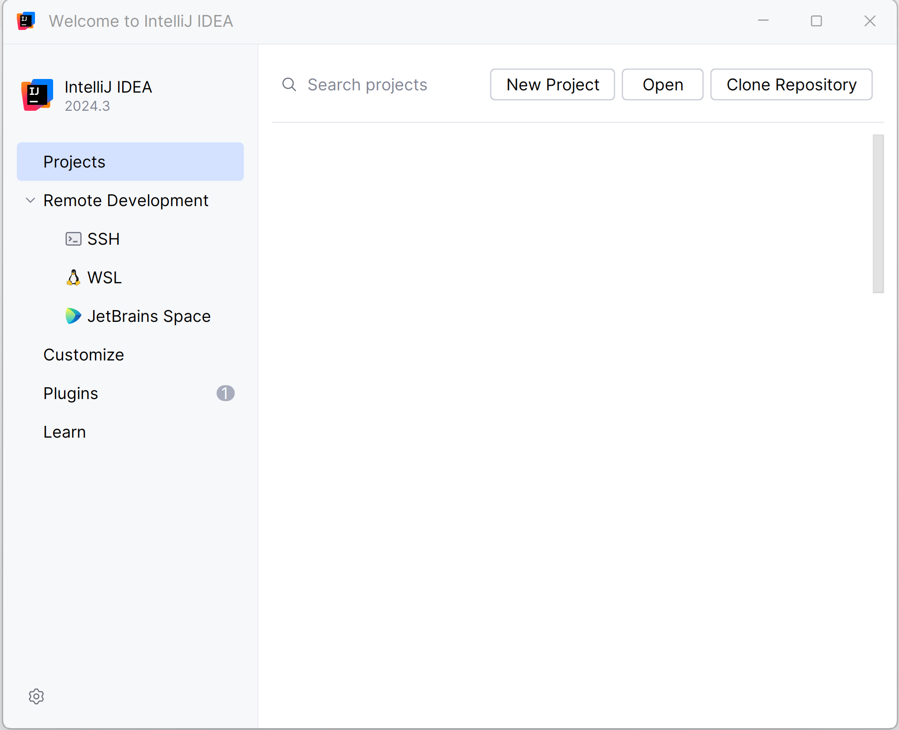

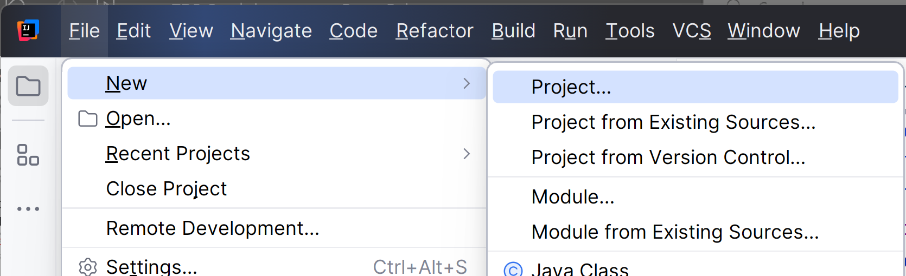
Create a New Project
When openning the first time (no current project)
When re-openning (already a current project)

Slide 7
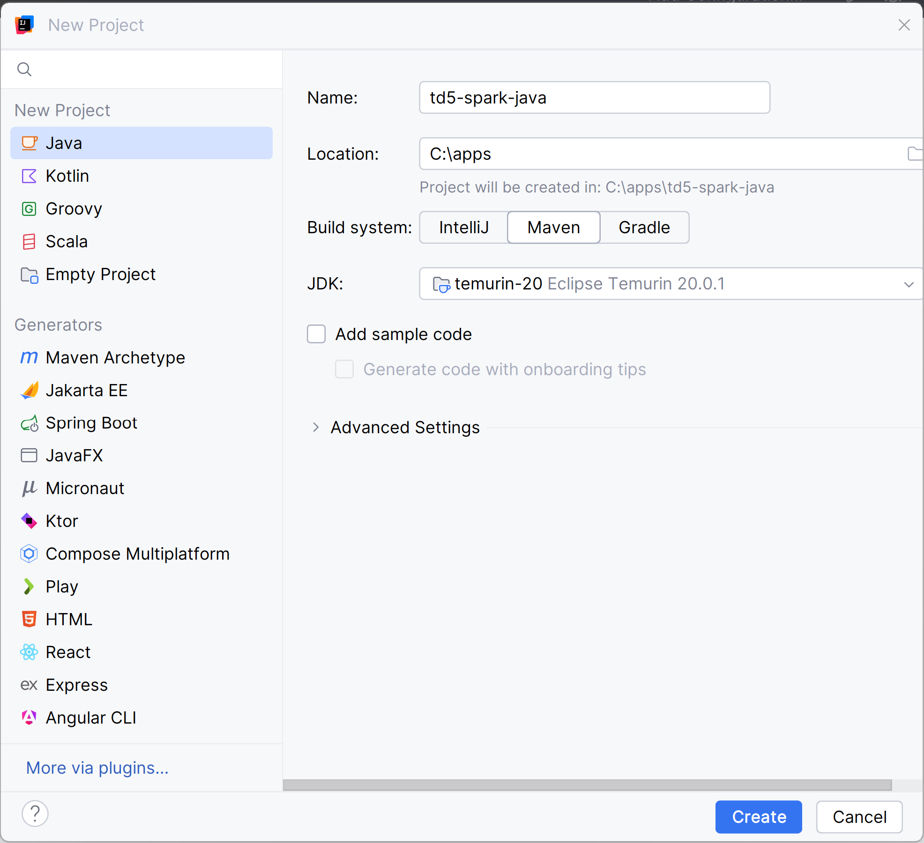
Create New Java (build with Maven) Project

Slide 8
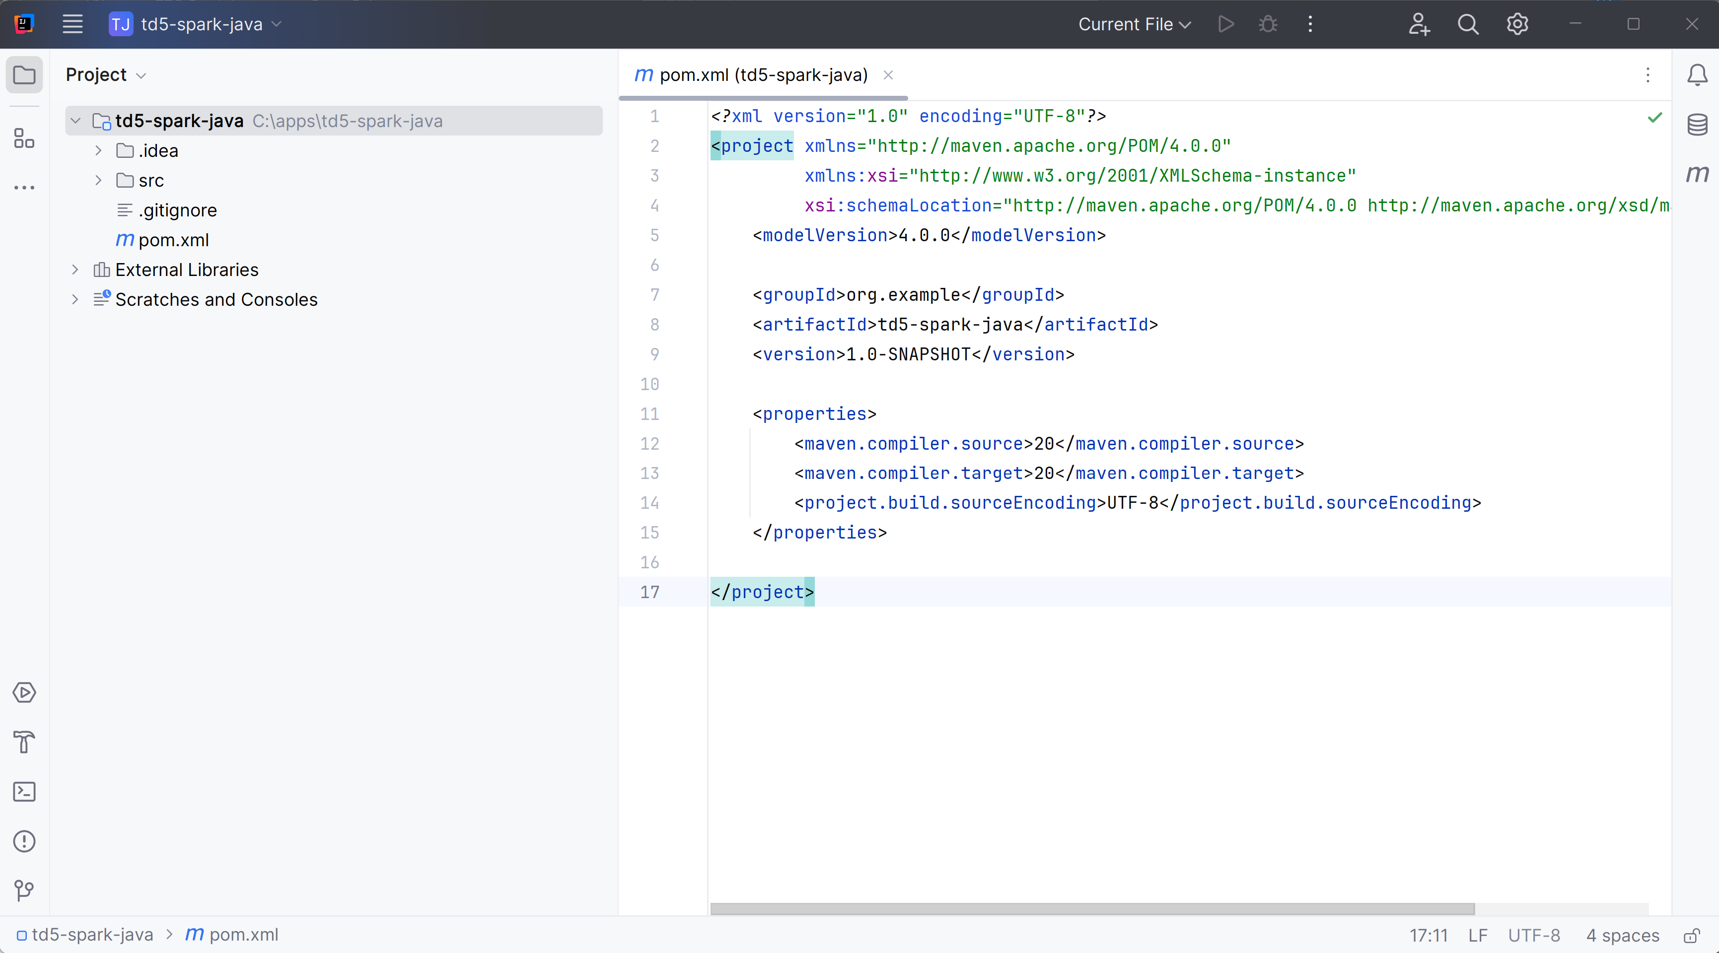
pom.xml file (pom = Project Object Model... for Maven build)

Slide 9
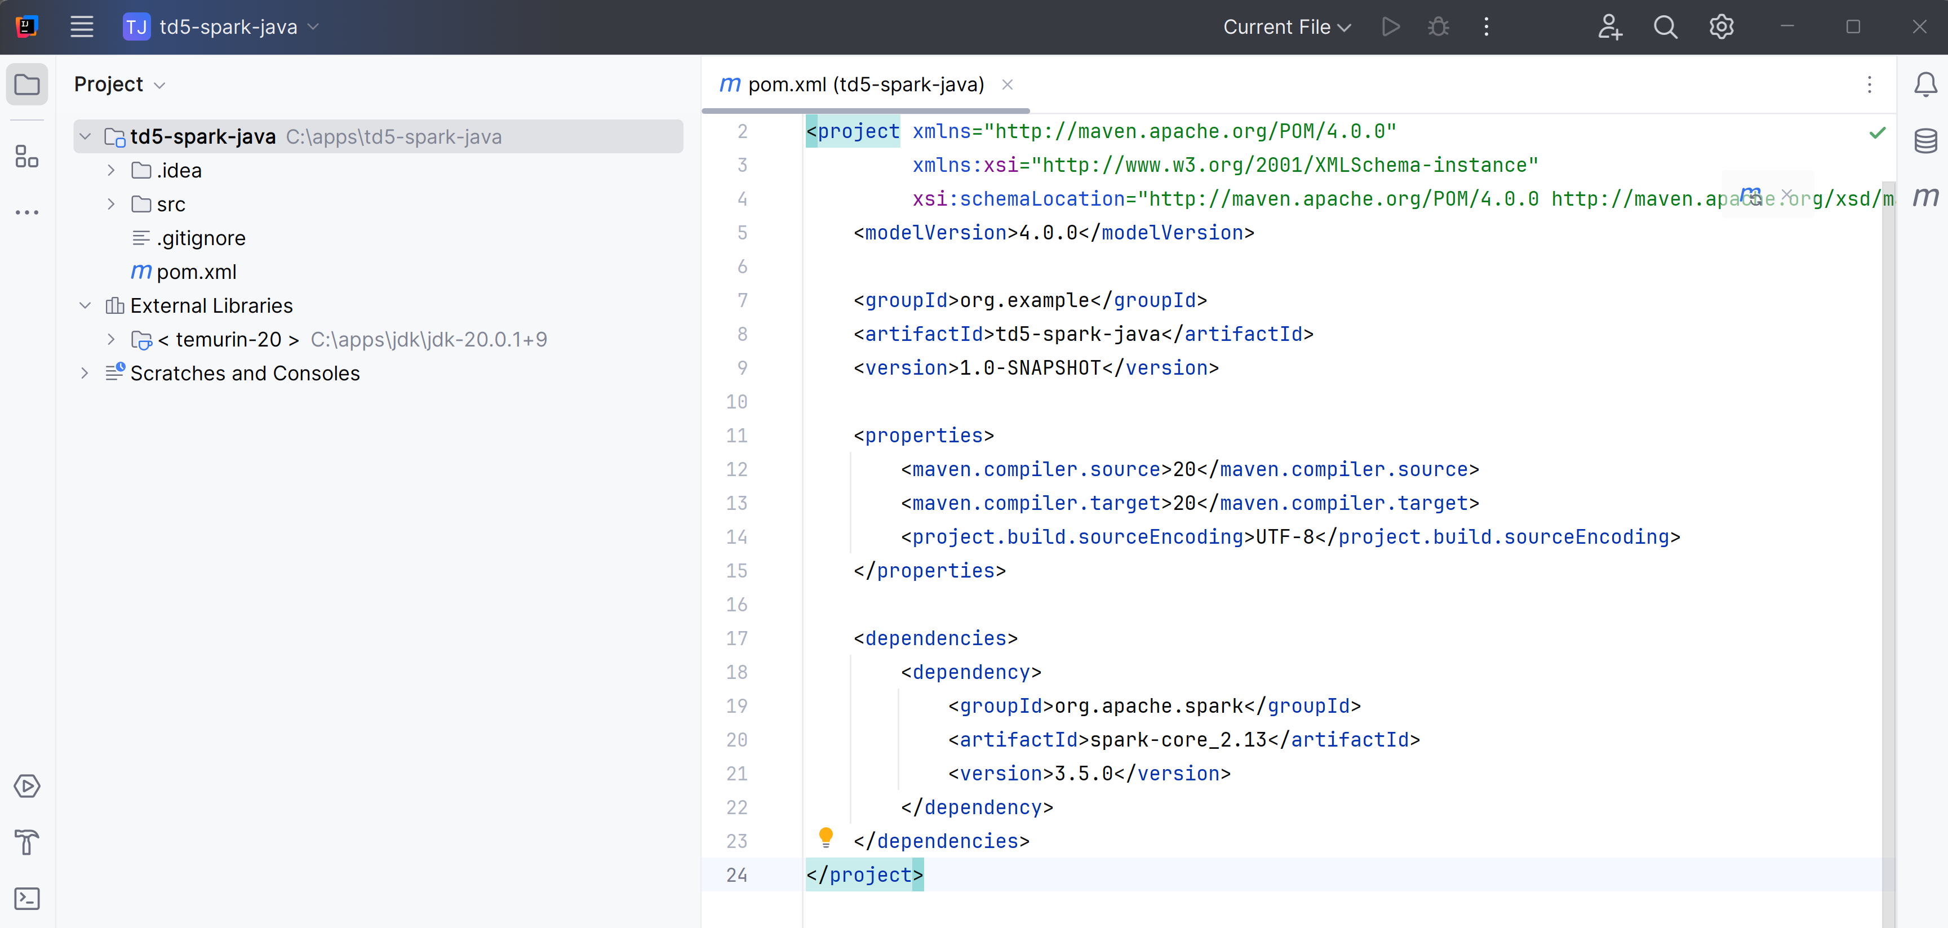
Edit to add maven <dependency>
<dependencies>
<dependency>
<groupId>org.apache.spark</groupId>
<artifactId>spark-core_2.13</artifactId>
<version>3.5.0</version>
</dependency>
</dependencies>

Slide 10
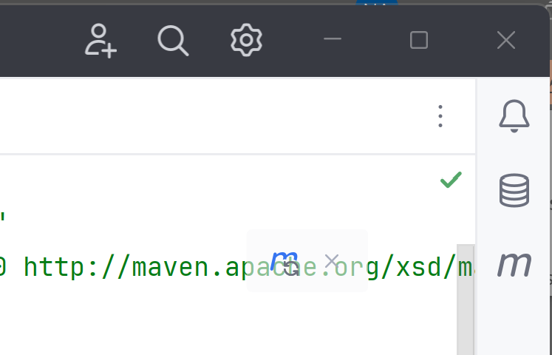
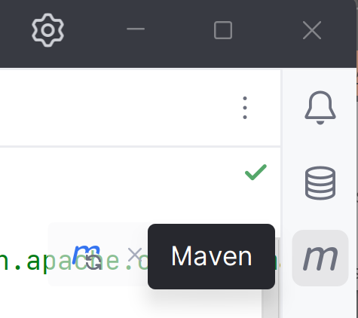
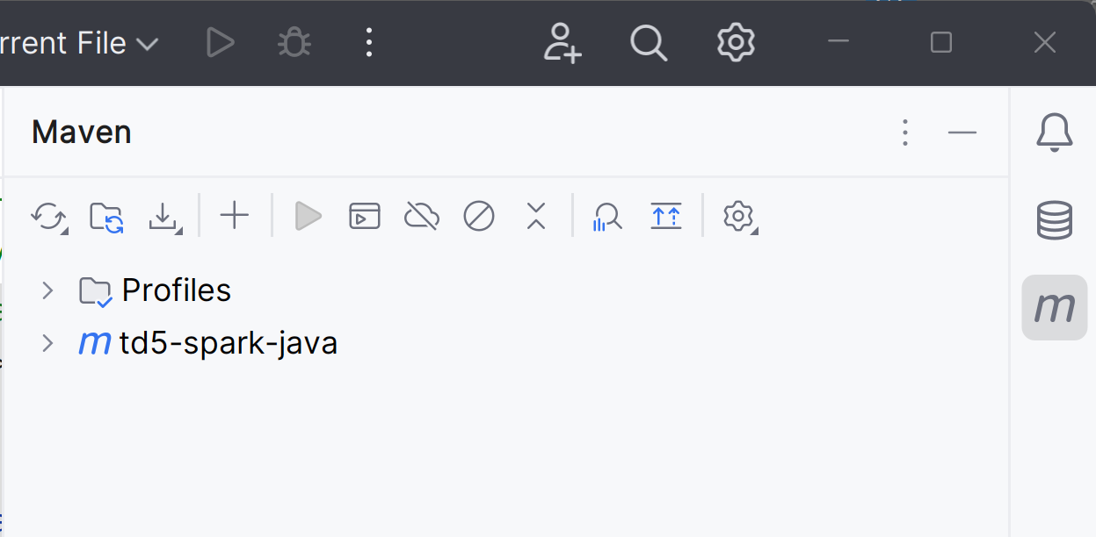
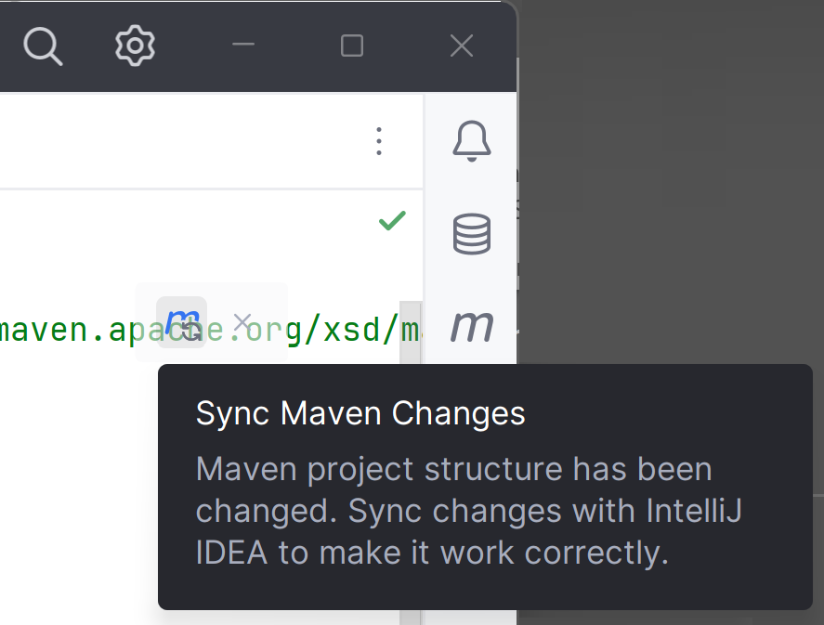
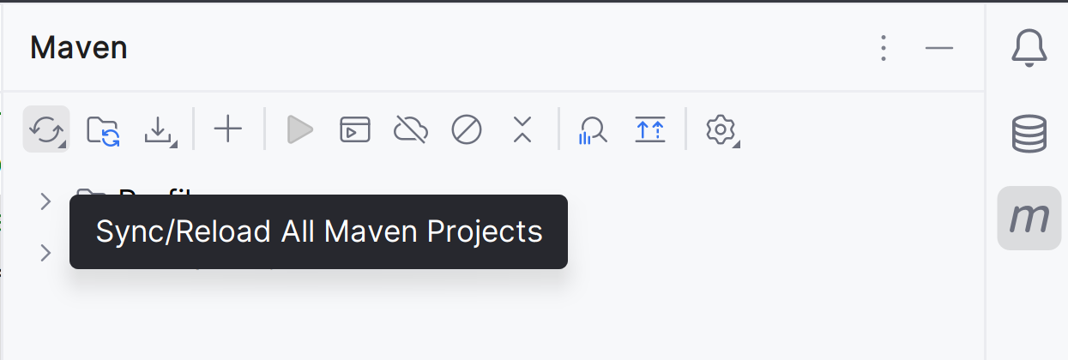
Then Click on "Maven Sync" icon
difficult to see inside text editor
can also do from right "m"=Maven button

Slide 11
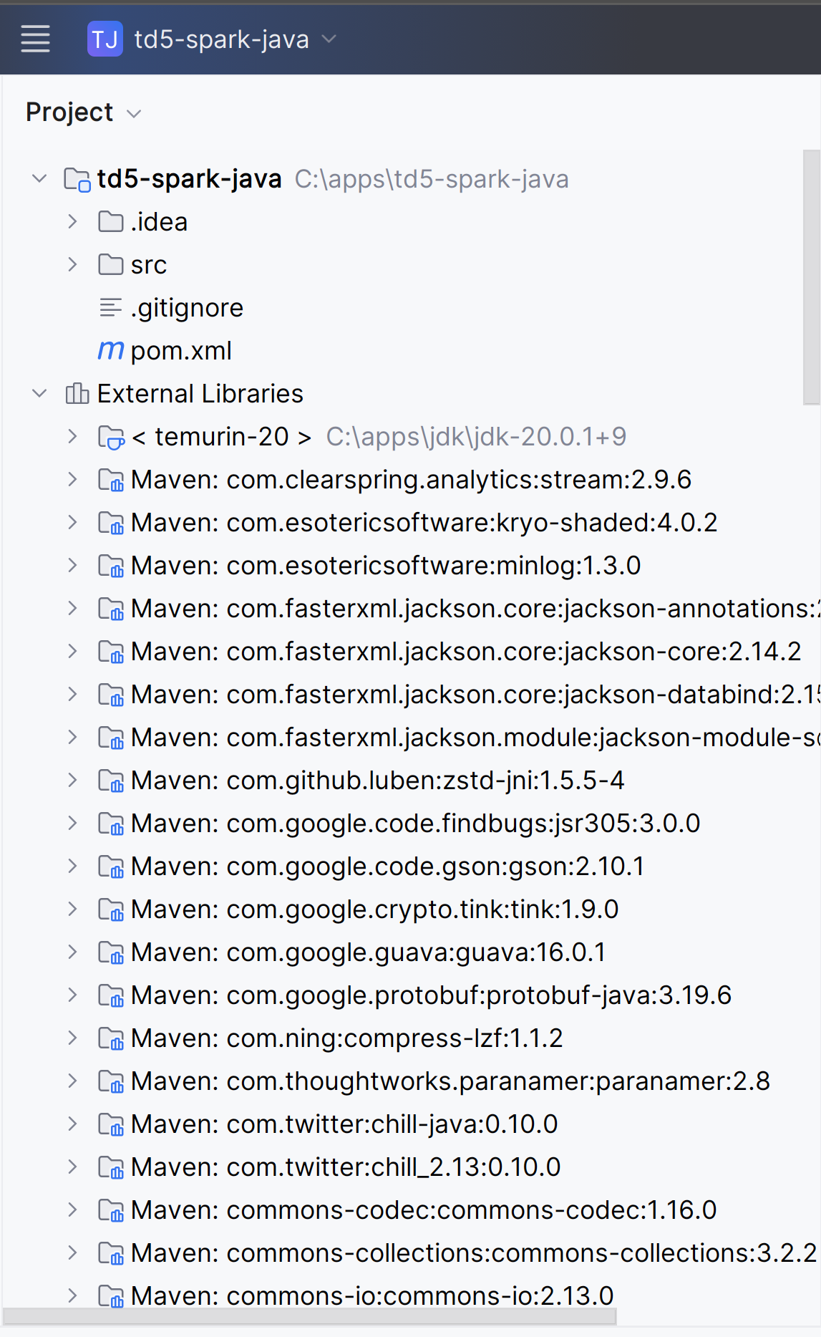
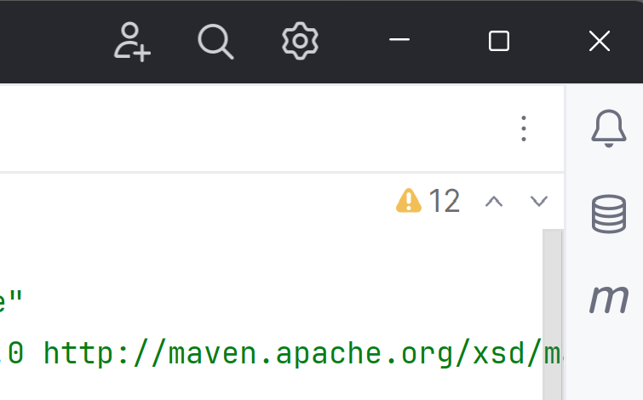
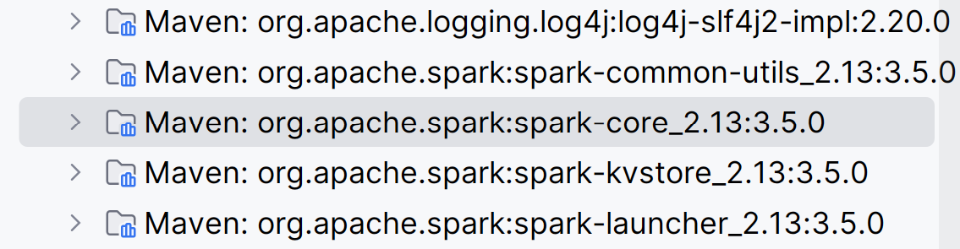
Maven will download dependencies ... can take ~5mn
The "External Libraries"
now contains hundreds
of Maven dependencies
... including spark
The "Sync" icon will disapear
The progress bar will show "resolving dependencies" / "downloading"

Slide 12
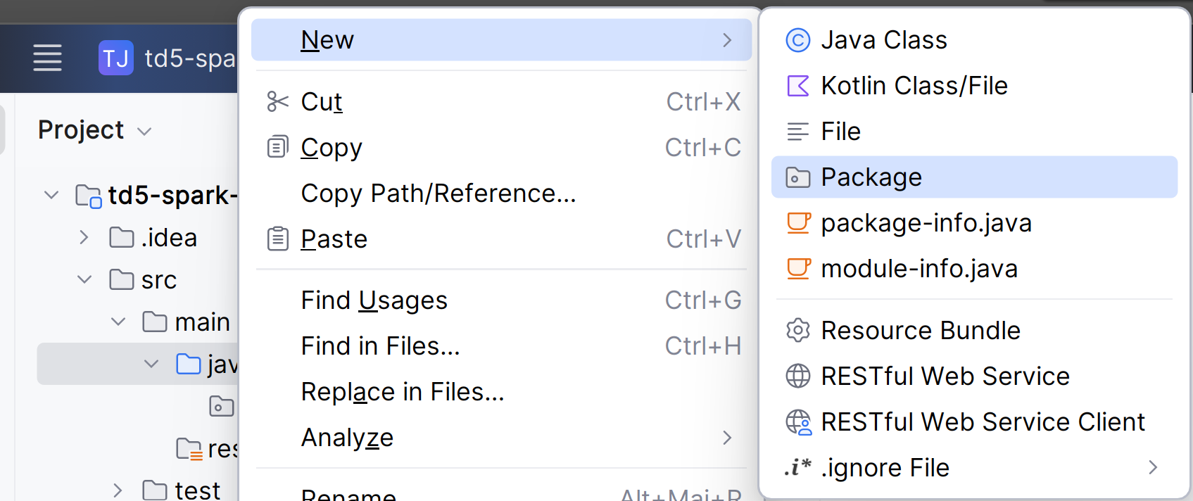
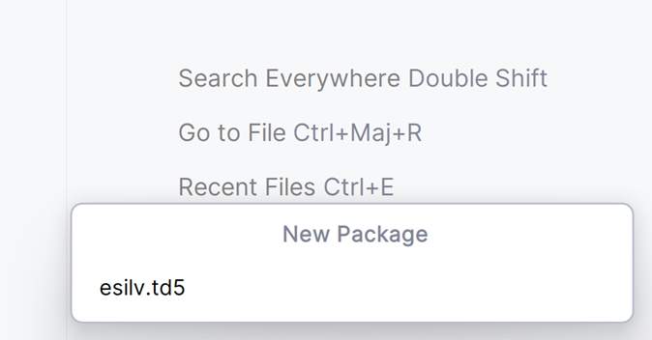
Create a new Package: "esilv.td5"

Slide 13
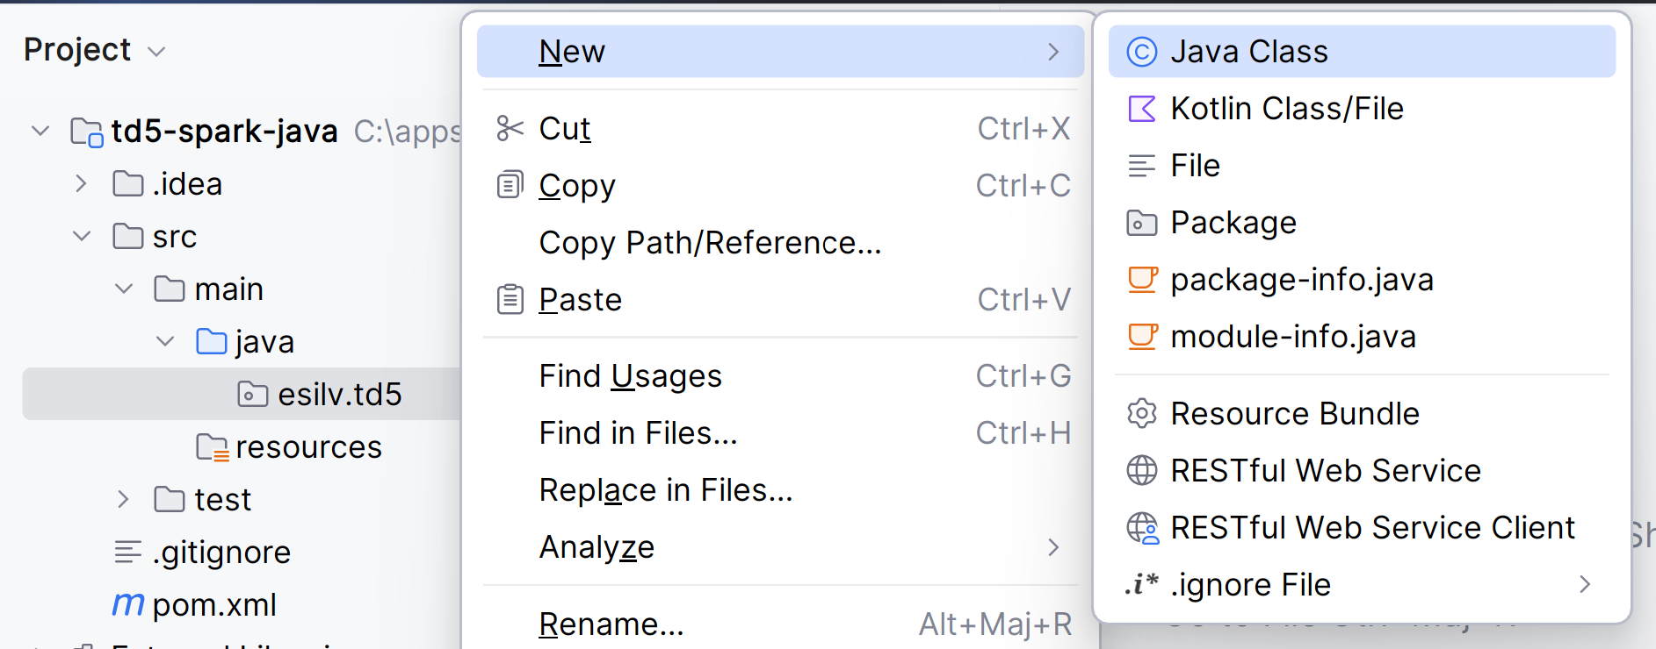
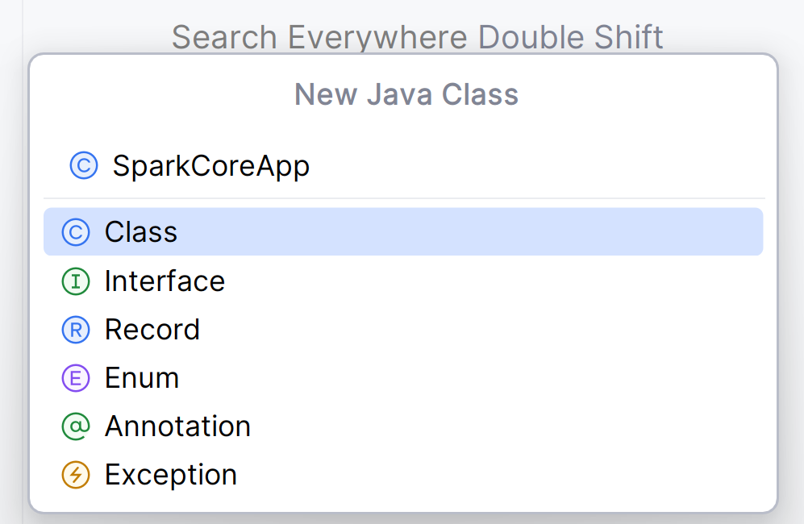
Create a new Java class "SparkCoreApp" in package esilv.td5

Slide 14
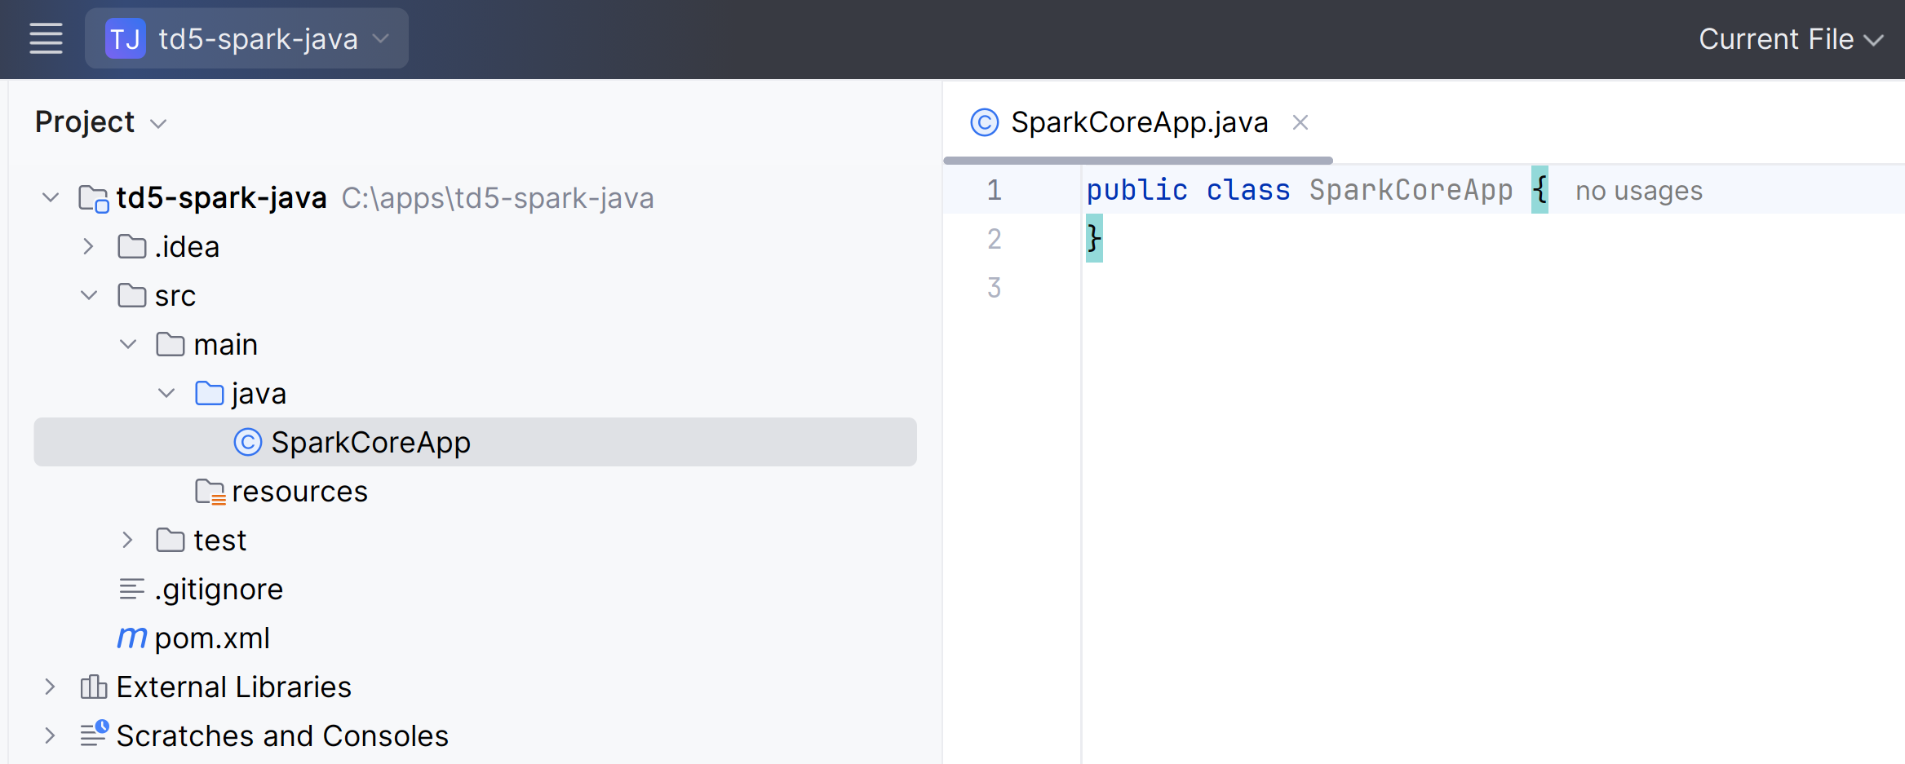
BAD ... using no package name

Slide 15
in main() initialise spark-core "SparkContext" singleton ( we will see later SparkSession in spark-sql)
import org.apache.spark.SparkConf;
import org.apache.spark.SparkContext;
import org.apache.spark.rdd.RDD;
public class SparkCoreApp {
public static void main(String[] args) {
SparkConf sparkConf = new SparkConf()
.setAppName("td5-sparkcore-app")
.setMaster("local[*]");
SparkContext sc = SparkContext.getOrCreate(sparkConf);
RDD<String> lineRdd = sc.textFile("c:/data/loremIpsum.txt", 1);
long lineCount = lineRdd.count();
System.out.println("line count:" + lineCount);
sc.stop();
}
}

Slide 16


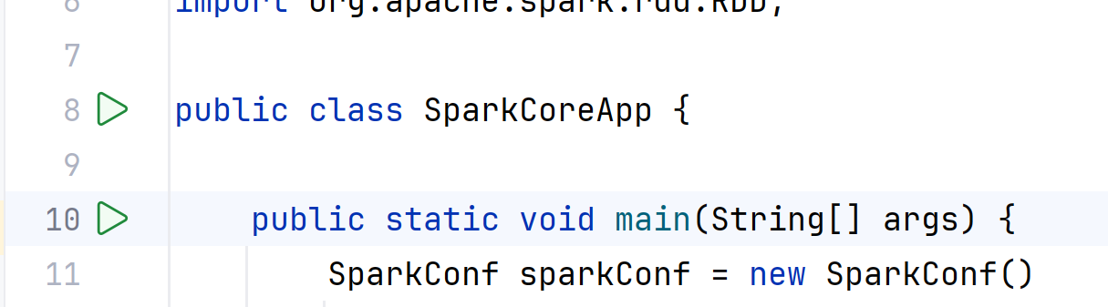

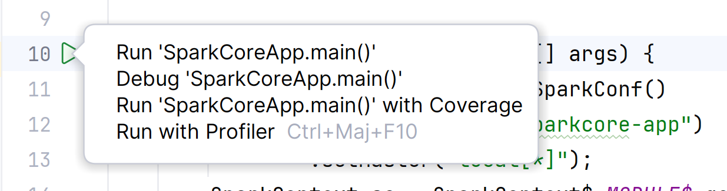
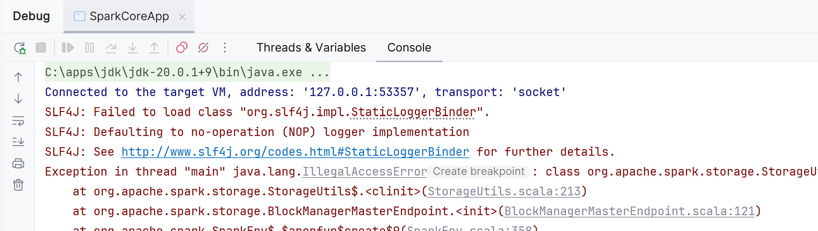
Debug (or Run ) will FAIL on jdk >=11 and work on jdk <11

Slide 17
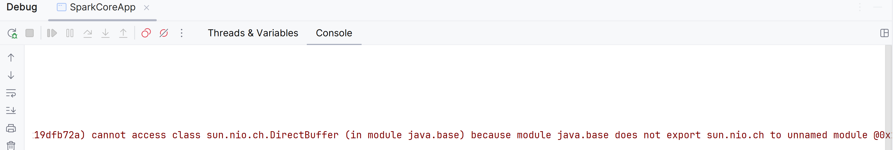
Failure cause : java security on modules

Slide 18
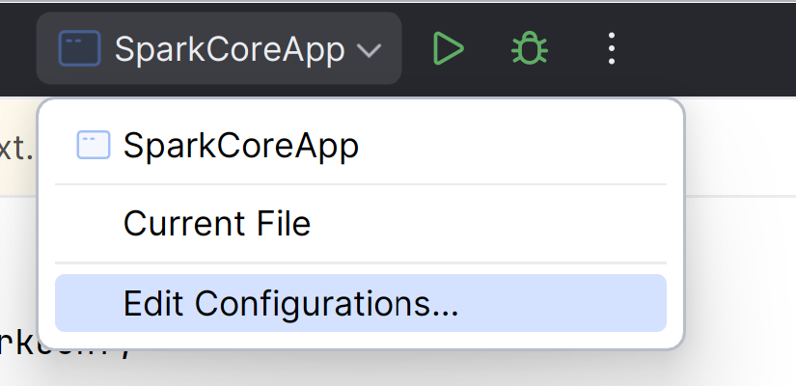
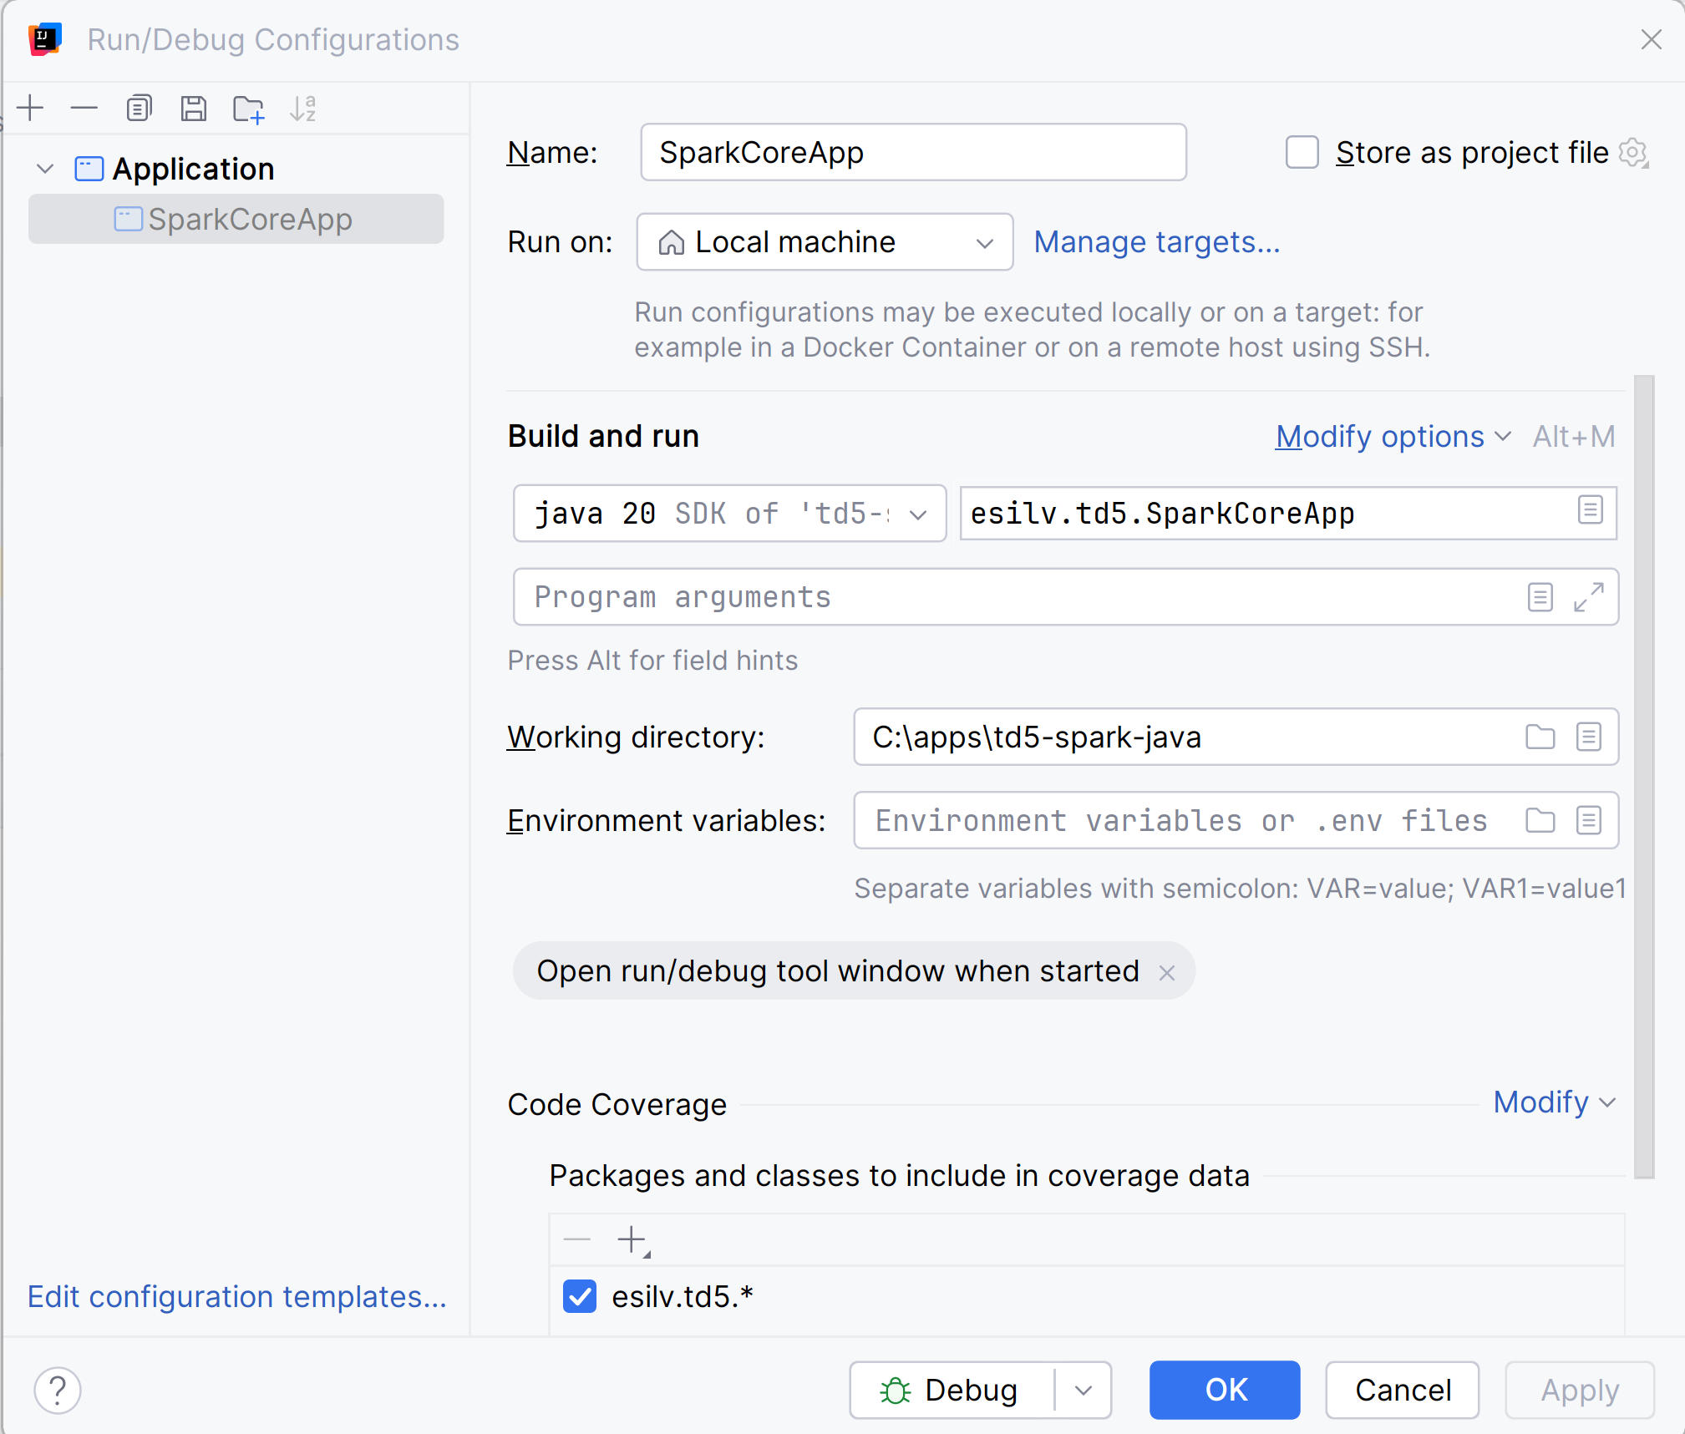
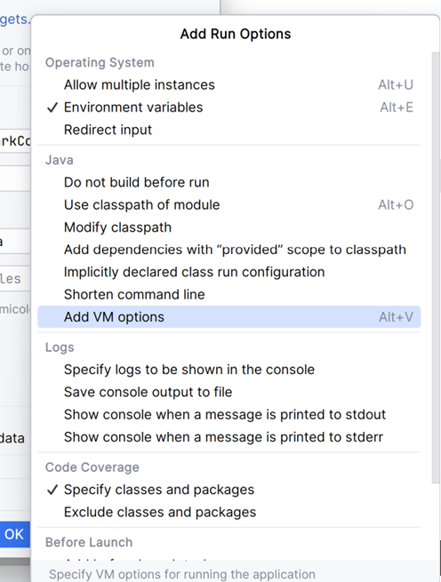
Edit Run/Debug Config - JVM Options

Slide 19
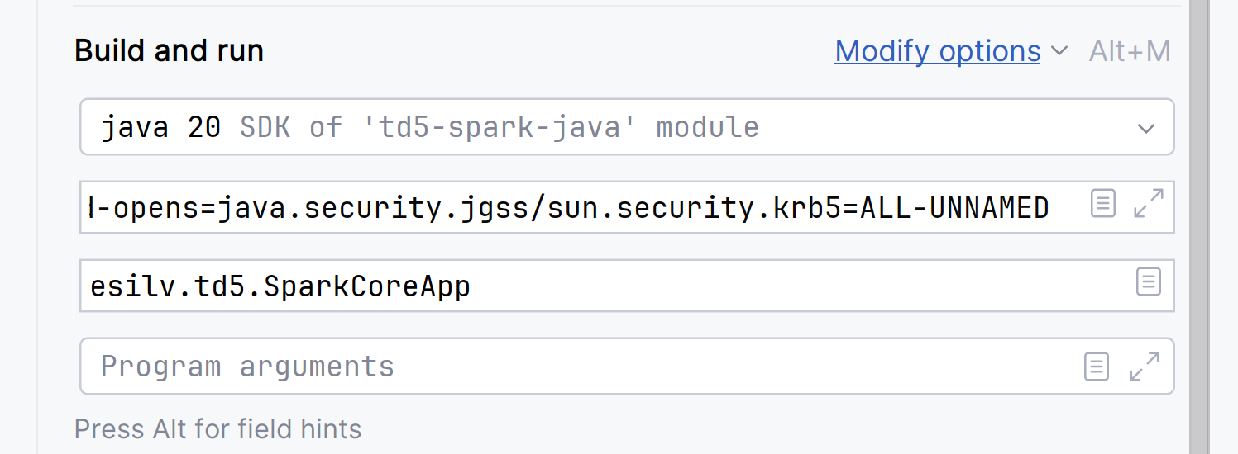
add JVM options
-Xmx3g
--add-opens=java.base/java.lang=ALL-UNNAMED
--add-opens=java.base/java.lang.invoke=ALL-UNNAMED
--add-opens=java.base/java.lang.reflect=ALL-UNNAMED
--add-opens=java.base/java.io=ALL-UNNAMED
--add-opens=java.base/java.net=ALL-UNNAMED
--add-opens=java.base/java.nio=ALL-UNNAMED
--add-opens=java.base/java.util=ALL-UNNAMED
--add-opens=java.base/java.util.concurrent=ALL-UNNAMED
--add-opens=java.base/java.util.concurrent.atomic=ALL-UNNAMED
--add-opens=java.base/sun.nio.ch=ALL-UNNAMED
--add-opens=java.base/sun.nio.cs=ALL-UNNAMED
--add-opens=java.base/sun.security.action=ALL-UNNAMED
--add-opens=java.base/sun.util.calendar=ALL-UNNAMED
--add-opens=java.security.jgss/sun.security.krb5=ALL-UNNAMED

Slide 20
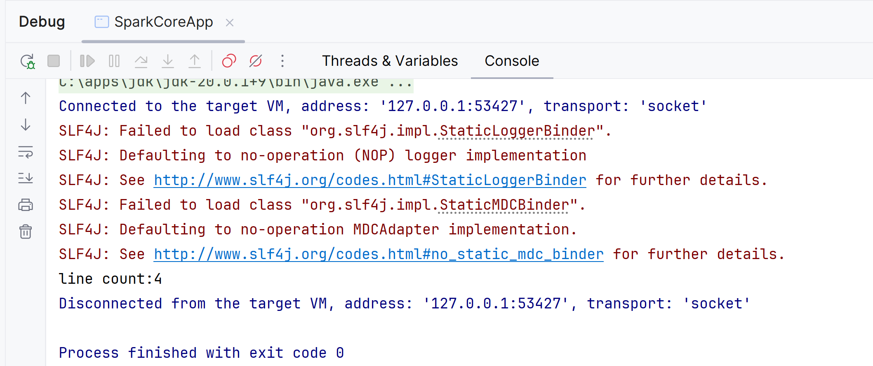
Relaunch ... it works

Slide 21
Changing to use module spark-sql SparkSession

Slide 22
Edit pom.xml + Maven Sync Changes
<dependency>
<groupId>org.apache.spark</groupId>
<artifactId>spark-sql_2.13</artifactId>
<version>3.5.0</version>
</dependency>
Notice: spark-sql_2.13 dependends on spark-core_2.13
... you can remove spark-core, it is implicit dependency

Slide 23
create new class "SparkSqlApp"
import org.apache.spark.SparkConf;
import org.apache.spark.sql.Dataset;
import org.apache.spark.sql.SparkSession;
public class SparkSqlApp {
public static void main(String[] args) {
SparkConf sparkConf = new SparkConf()
.setAppName("td5-sparksql-app")
.setMaster("local[*]");
SparkSession spark = SparkSession.builder()
.config(sparkConf) .getOrCreate();
Dataset<String> lineDs = spark.read().textFile("c:/data/loremIpsum.txt");
long lineCount = lineDs.count();
System.out.println("line count:" + lineCount);
spark.stop();
}
}

Slide 24
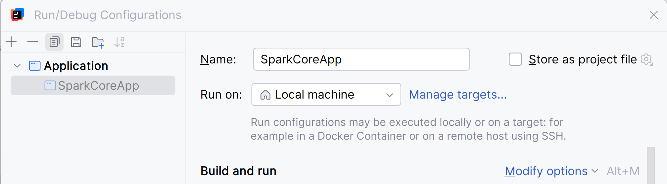
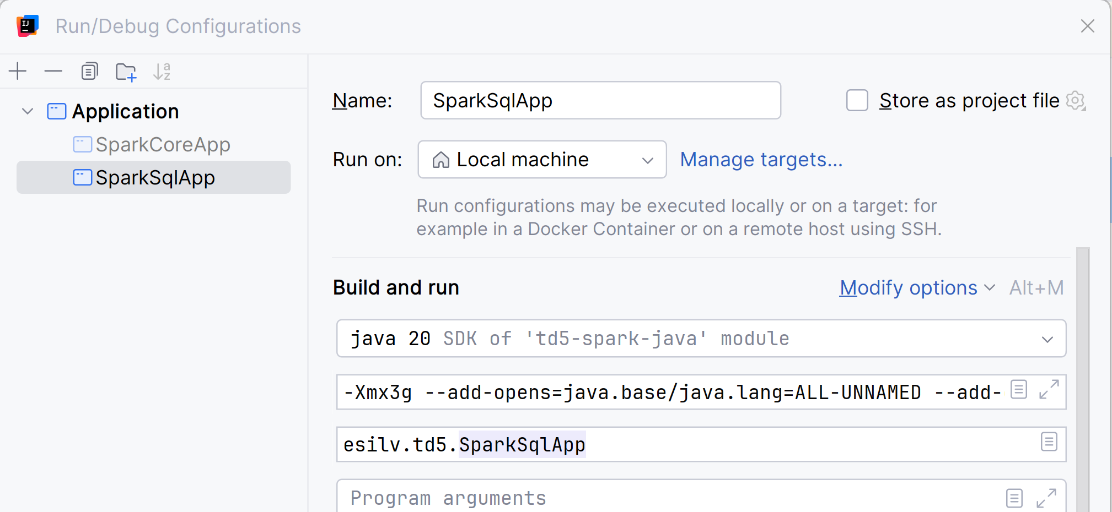
Duplicate Run/Debug Configurations (or Edit similar VM Options) ... Debug

Slide 25
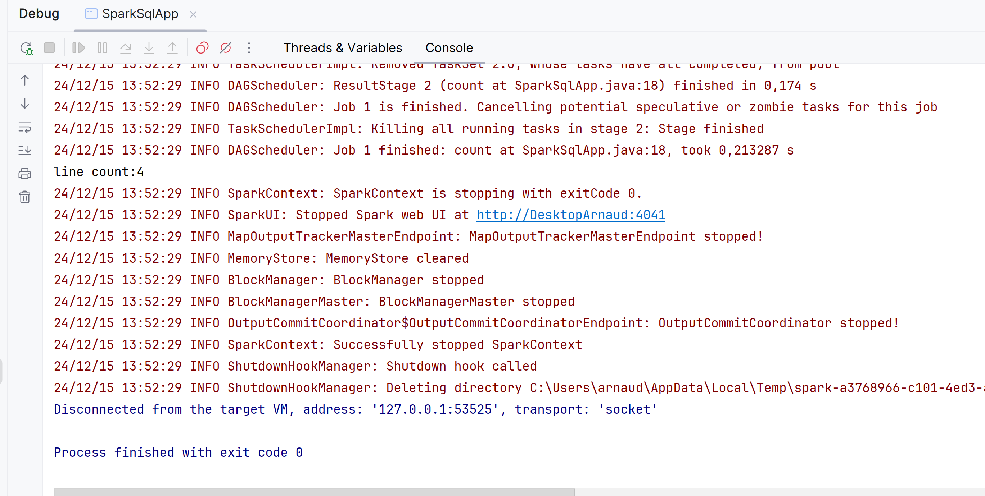
Debug ... it works

Slide 26
using Dataset API with Encoders

Slide 27
createDataset .. need Encoder
List<String> testList = Arrays.asList("hello", "world");
Dataset<String> testDs = spark.createDataset( ??????? ); // <== complete missing code
System.out.println("testDs count:" + testDs.count());

Slide 28
HINT ..
List<String> stringList = Arrays.asList("hello", "world");
Dataset<String> testDs = spark.createDataset(stringList, Encoders.STRING());
System.out.println("testDs count:" + testDs.count());

Slide 29
Dataset<String> .map() to use upper-cases
Dataset<String> testUpperDs = testDs.map( ?????? x -> x.toUpperCase(), // <== complete missing code ?????? // <== complete missing code );
System.out.println("testUpperDs.show()");
testUpperDs.show();
+-----+
|value|
+-----+
|HELLO|
|WORLD|
+-----+

Slide 30
HINT .map()
Dataset<String> testUpperDs = testDs.map( (MapFunction<String, String>) x -> x.toUpperCase(),
Encoders.STRING());
System.out.println("testUpperDs.show()");
testUpperDs.show();

Slide 31
Exerise : implement "Words Count" on file "loremIpsum.txt"
Dataset<String> wordDs = lineDs.flatMap( ???????? line -> { // <======= complete missing code
String[] split = line.replaceAll("[,;\\.?!]", " ").replace(" ", " ").split(" ");
return Arrays.asList(split).iterator();
},
???????? ); // <======= complete missing code
wordDs.cache();
long wordCount = wordDs.count();
System.out.println("words count: " + wordCount);
System.out.println("words:");
wordDs.show();

Slide 32
Words Count
Dataset<String> wordDs = lineDs.flatMap((FlatMapFunction<String, String>) line -> {
String[] split = line.replaceAll("[,;\\.?!]", " ").replace(" ", " ").split(" ");
return Arrays.asList(split).iterator();
},
Encoders.STRING());
wordDs.cache();
long wordCount = wordDs.count();
System.out.println("words count: " + wordCount);
System.out.println("words:");
wordDs.show();

Slide 33
using Java Bean Encoders Dataset<YourBean> --> to DataFrame ". toDF()" DataFrame --> ".as()" Dataset<YourBean>

Slide 34
Pre-Requisite : create a Pojo class YourBean
public class YourBean {
public int field1;
public String field2;
public YourBean() {
}
public YourBean(int field1, String field2) {
this.field1 = field1;
this.field2 = field2;
}
}

Slide 35
Convert List<YourBean> to Dataset<YourBean>
List<YourBean> beanLs = IntStream.rangeClosed(0, 10)
.mapToObj(i -> new YourBean(i, "Hello " + i))
.collect(Collectors.toList());
Dataset<YourBean> beanDs = spark.createDataset(beanLs, ??????); // <====== complete code
System.out.println("beanDs:");
beanDs.show();

Slide 36
HINT Encoders.bean(YourBean.class)
List<YourBean> beanLs = IntStream.rangeClosed(0, 10)
.mapToObj(i -> new YourBean(i, "Hello " + i))
.collect(Collectors.toList());
Dataset<YourBean> beanDs = spark.createDataset(beanLs, Encoders.bean(YourBean.class));
System.out.println("beanDs:");
beanDs.show();

Slide 37
Complete Dataset<YourBean> to DataFrame = Datasset<Row> and back to Dataset
Dataset<Row> beanDF = beanDs. ?????? // <==== complete missing code
System.out.println("beanDF:");
beanDF.show();
Dataset<YourBean> beanDs2 = beanDF. ?????? // <==== complete missing code
System.out.println("beanDs2:");
beanDs2.show();

Slide 38
HINT Ds.toDF() ; DF.as(encoder)
Dataset<Row> beanDF = beanDs.toDF();
System.out.println("beanDF:");
beanDF.show();
Dataset<YourBean> beanDs2 = beanDF.as(Encoders.bean(YourBean.class));
System.out.println("beanDs2:");
beanDs2.show();

Slide 39
Exercise Using spark.sql"(select * from hive_table")

Slide 40
Edit pom.xml again, add dependency
<dependency>
<groupId>org.apache.spark</groupId>
<artifactId>spark-hive_2.13</artifactId>
<version>3.5.0</version>
</dependency>

Slide 41
create new class SparkHiveSqlApp
public class SparkHiveSqlApp {
public static void main(String[] args) throws Exception {
System.out.println("current working dir: " + new File(".").getAbsolutePath()); SparkConf sparkConf = new SparkConf()
.setAppName("td5-sparkhivesql-app")
.setMaster("local[*]");
SparkSession spark = SparkSession.builder()
.config(sparkConf)
.enableHiveSupport() // <======= added !!! (need module spark-hive + working dir ..)
.getOrCreate();
spark.sql("show databases").show(100, false); spark.sql("show tables in db1").show(100, false);
Dataset<Row> addrDs = spark.sql("select * from db1.addr");
System.out.println("addrDs count:" + addrDs.count());
System.out.println("Finished\n\n");
spark.stop();
}
}

Slide 42
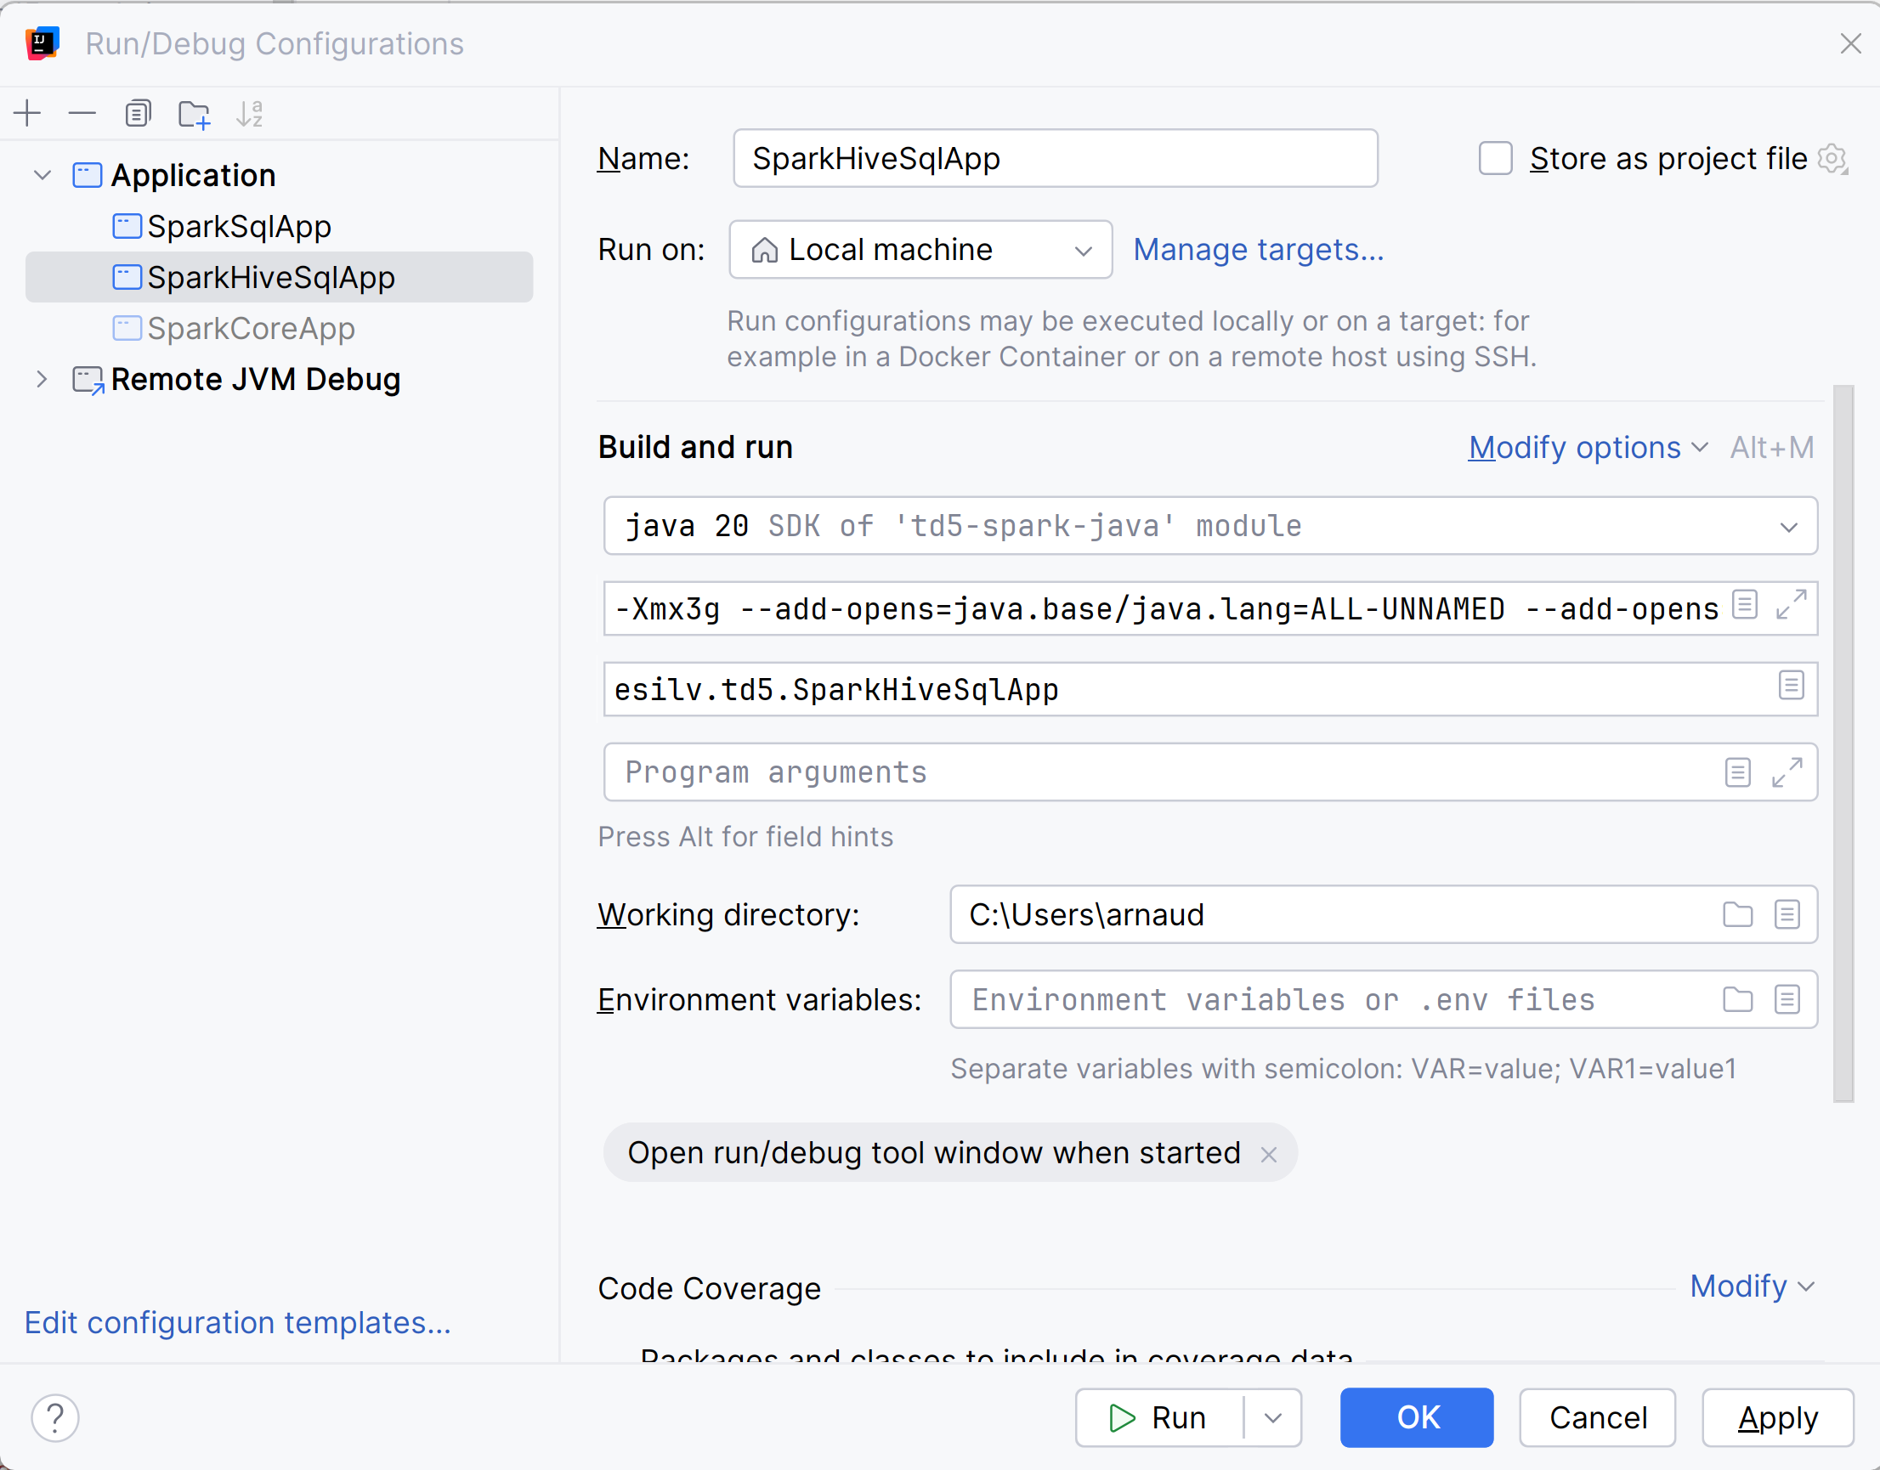
Run... need to set "currentWorkingDir"

Slide 43
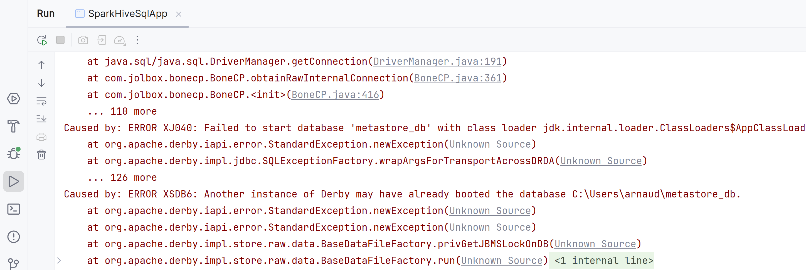
Already Locked ?? (=> need to stop all others running "spark-shell")

Slide 44
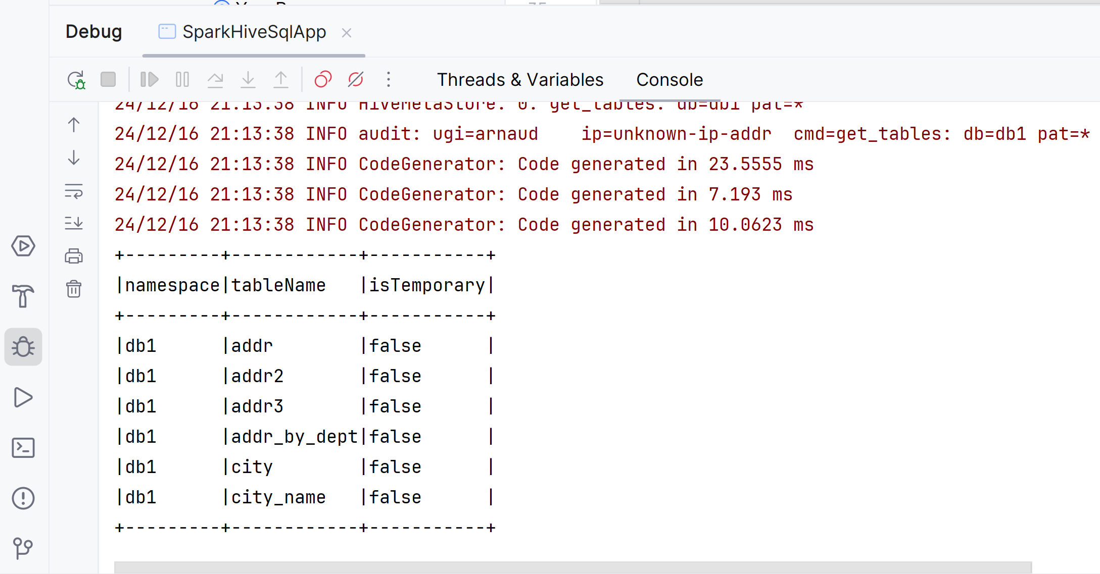
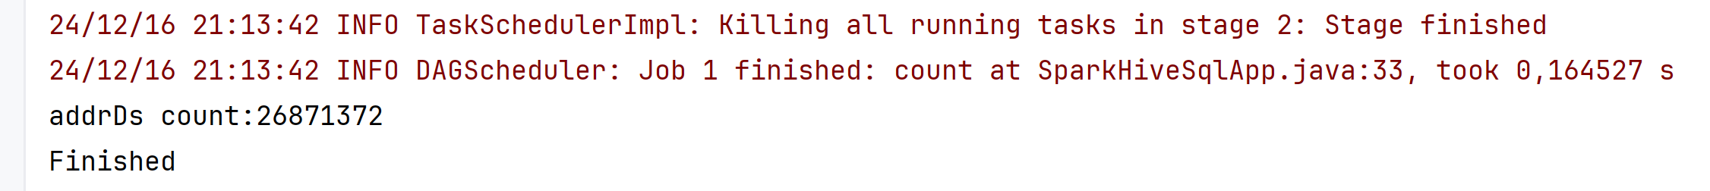
It works..

Slide 45
Launching from Terminal "spark-submit"

Slide 46
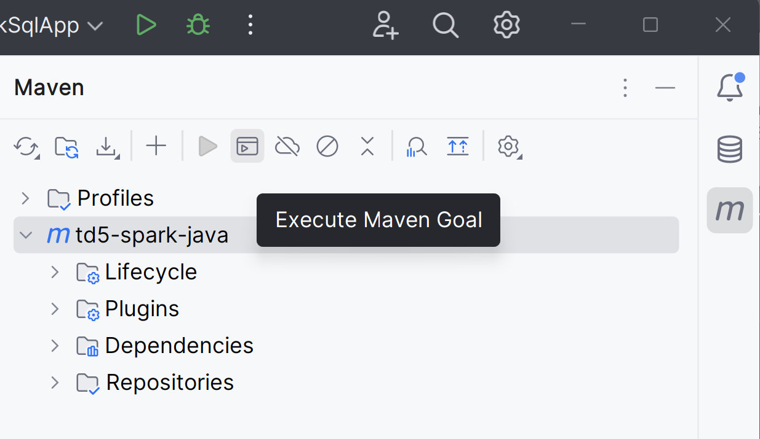
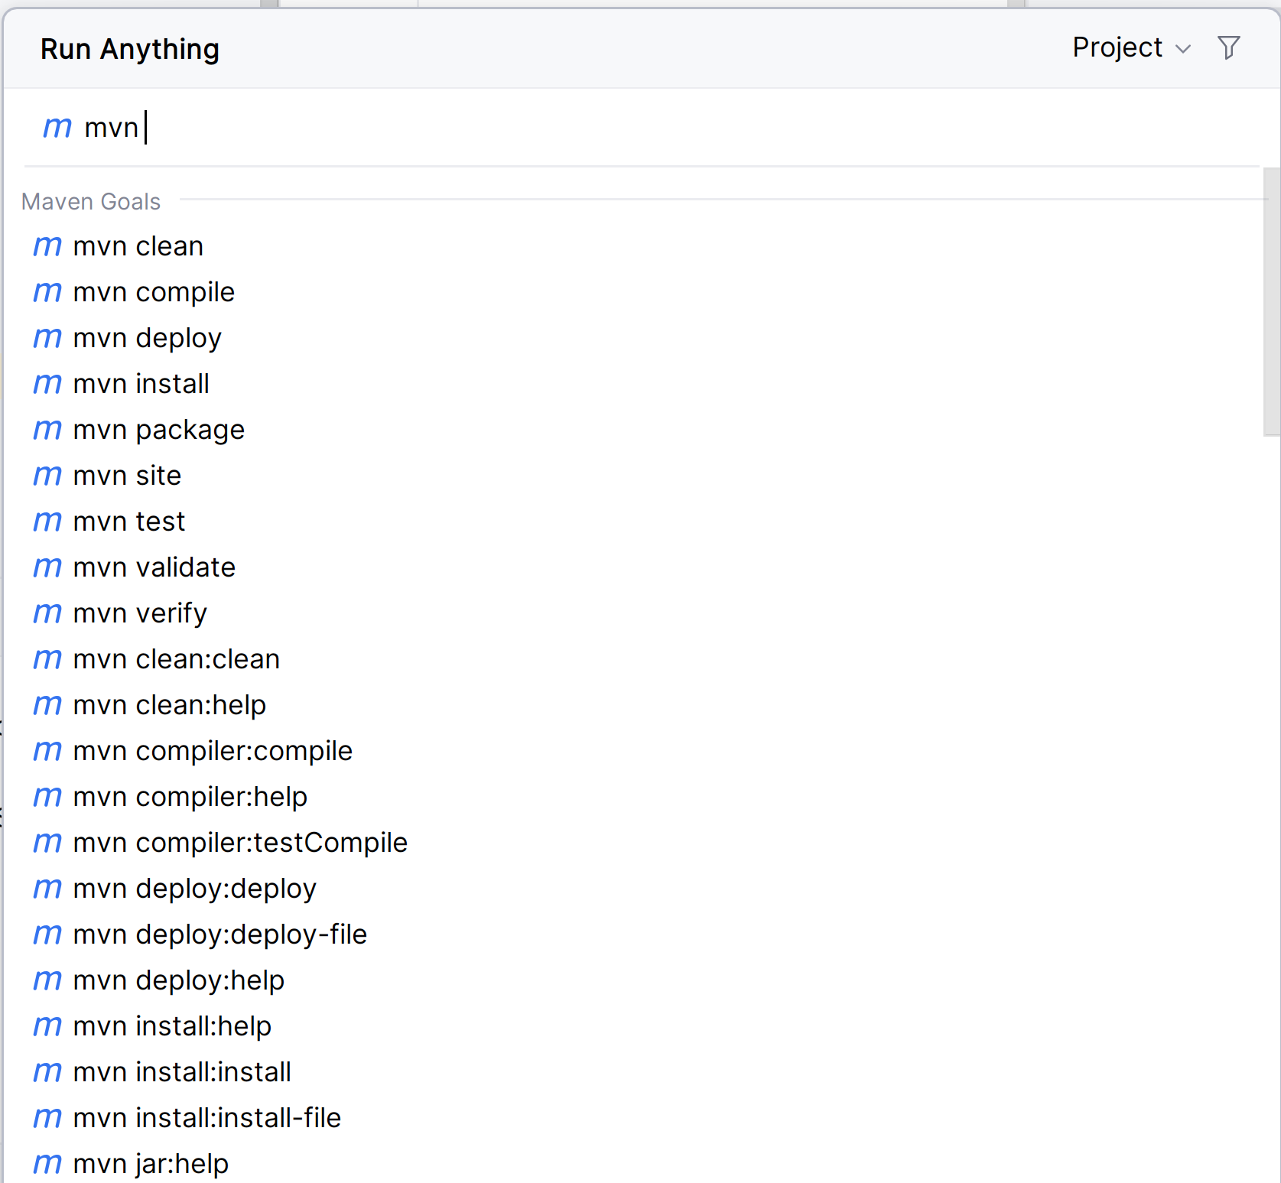
Build jar using "mvn package"

Slide 47
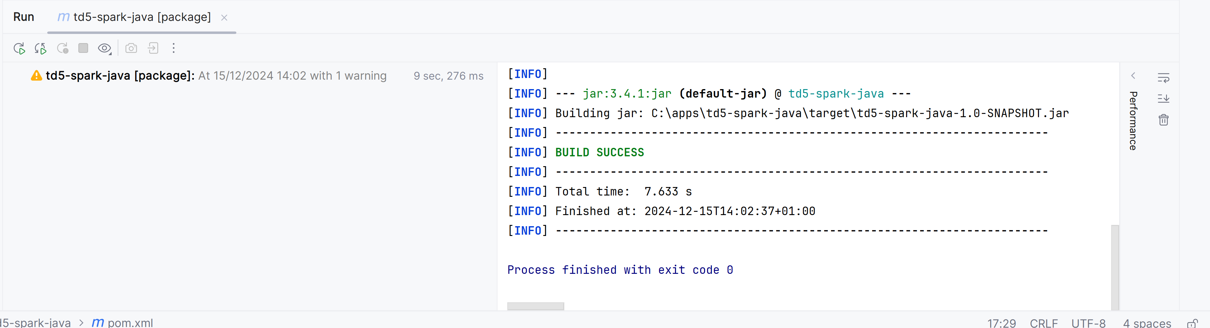
Built jar: "target/td5-spark-java-1.0-SNAPSHOT.jar"

Slide 48
spark-submit
cd td5-spark-java
spark-submit --class esilv.td5.SparkSqlApp target\td5-spark-java-1.0-SNAPSHOT.jar

Slide 49
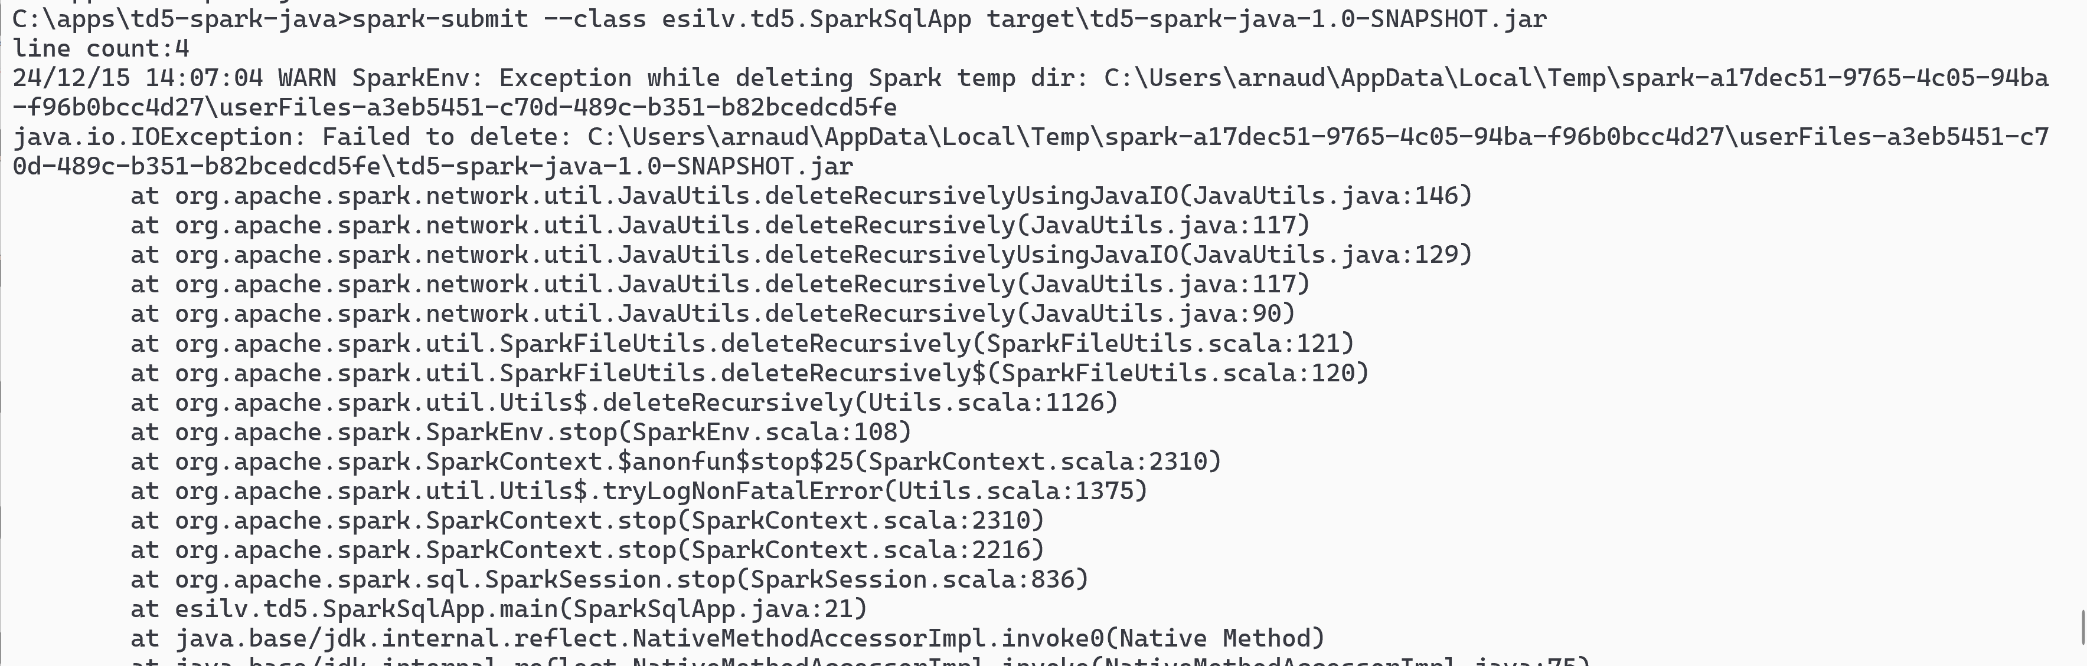
it "works" ... but on Windows, fails to "stop()" cleanly (delete temp dir where jar locked)

Slide 50
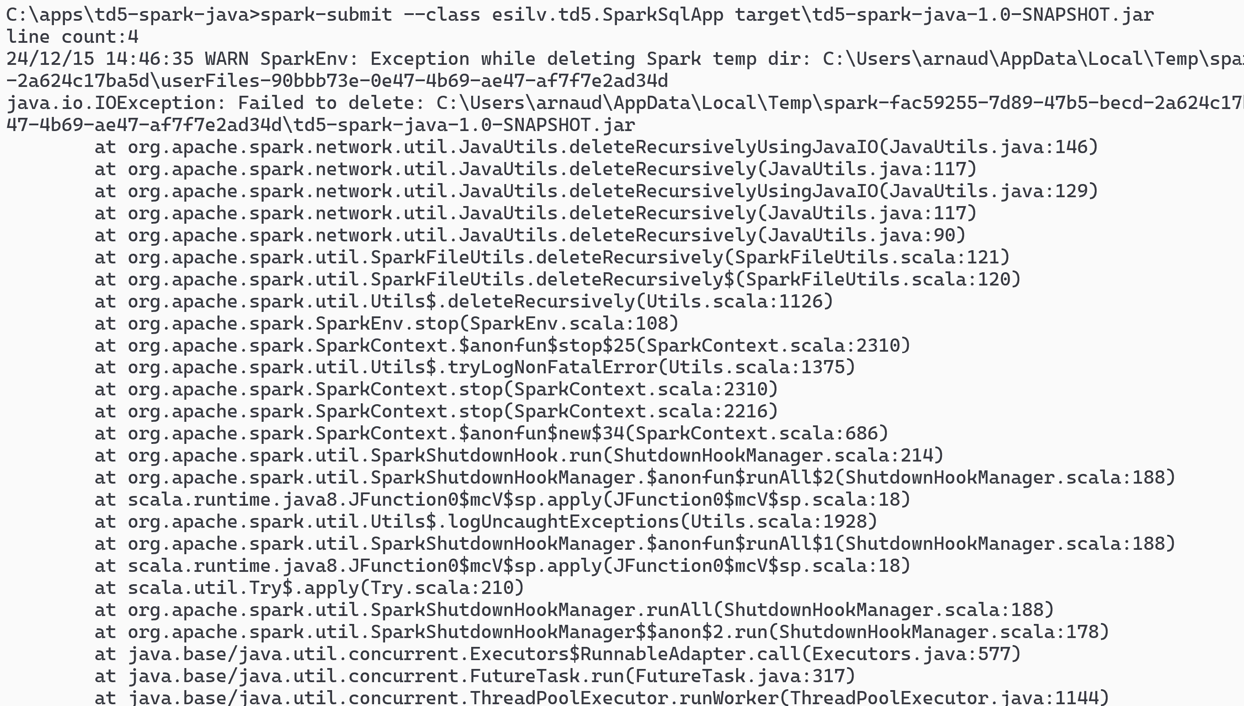
even with no explicit .stop() always called by SparkShutdowHookManager

Slide 51
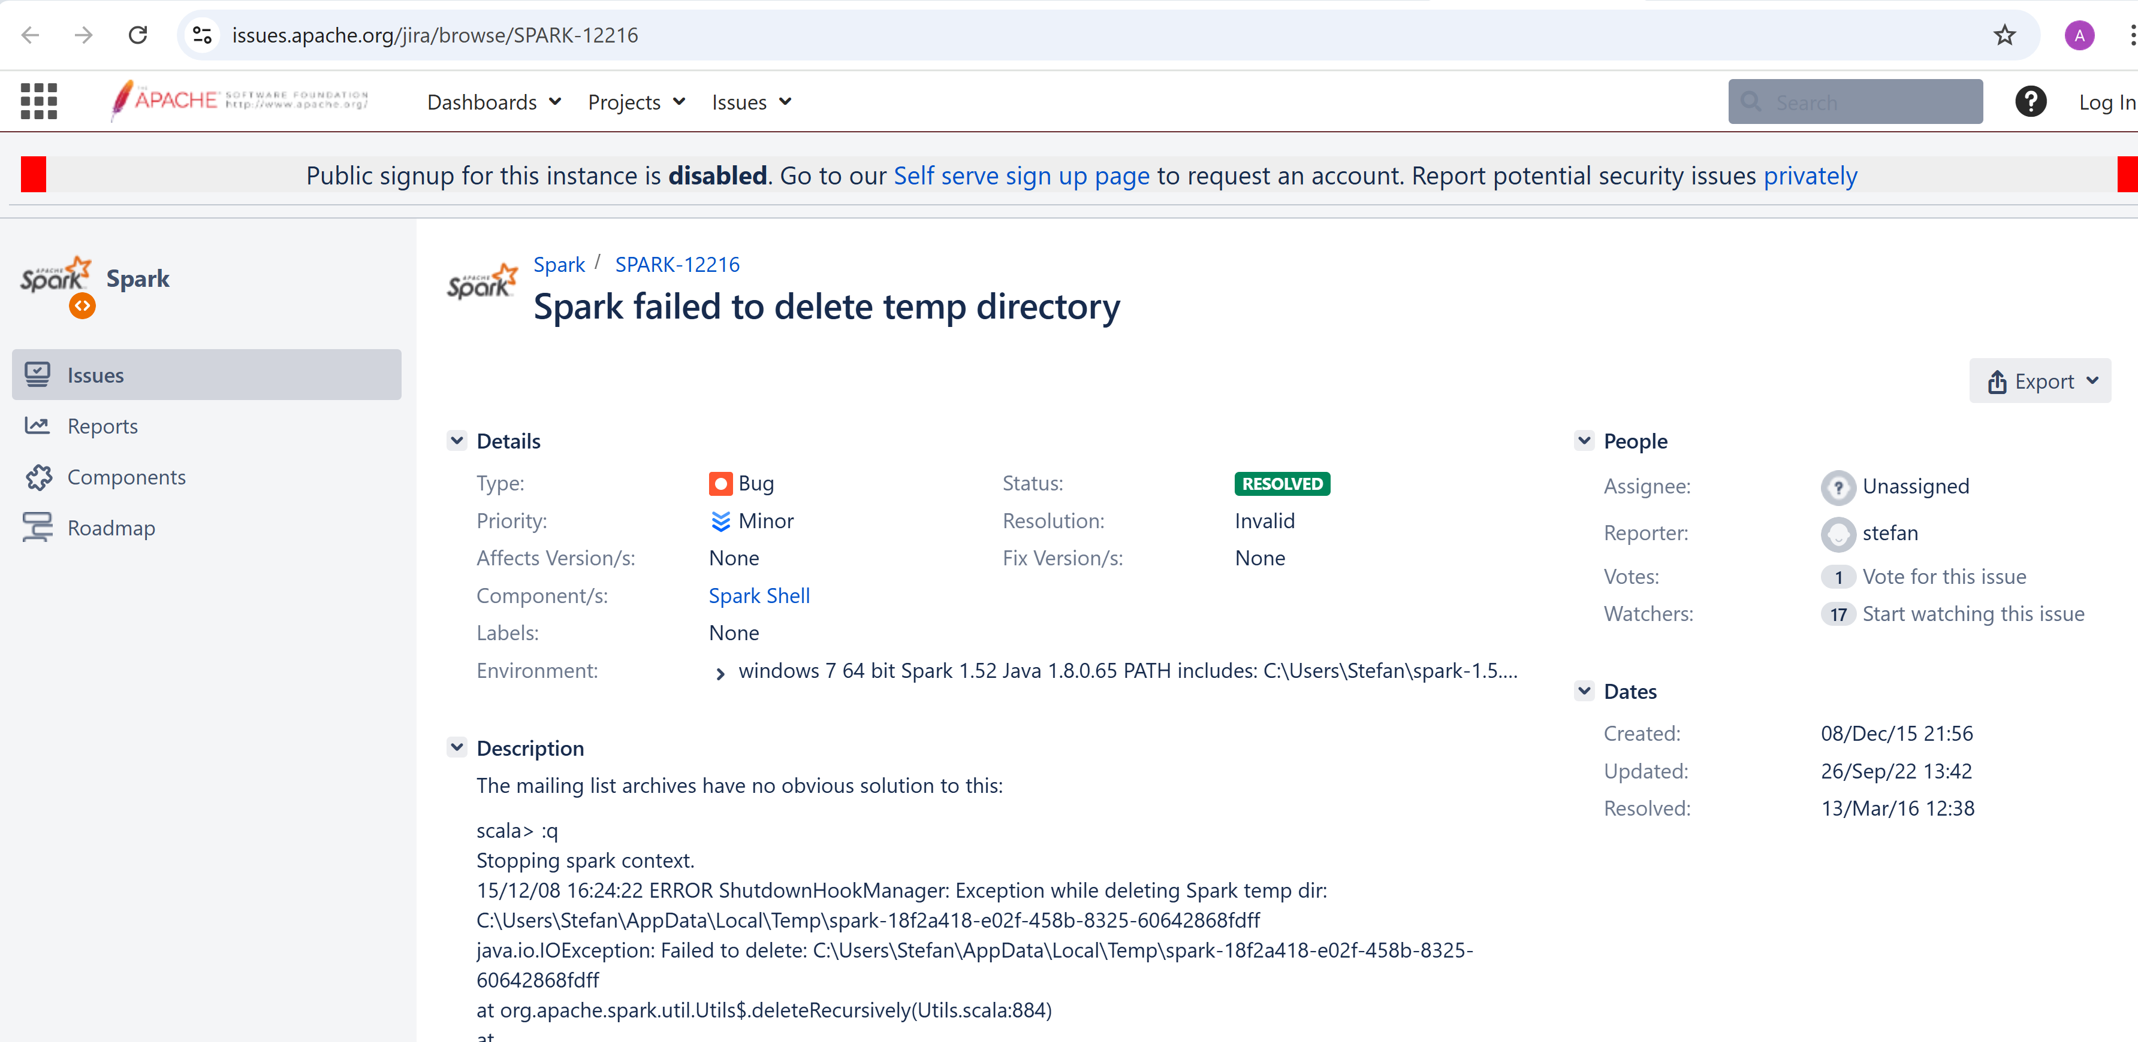

Notice: Lock considered as Windows bug ... will be never fixed in Spark (!?)
bug since 2015..
closed() with workaround
"move to linux"

Slide 52
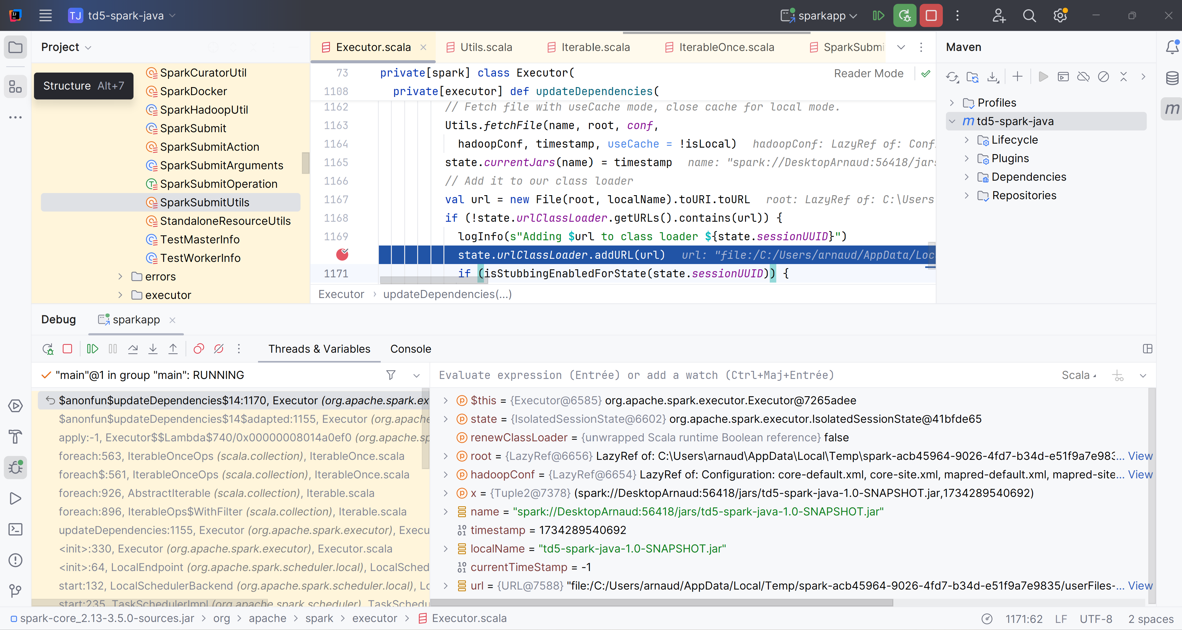
Curious why there are 2 jars in "local[*] mode? 1 in "driver" part + 1 locked (fetched) in "executor" part .. in Temp/
need JVM
remote debug
to see this ...

Slide 53
spark-submit with Remote JVM Debugging
DEBUG_CONF=--conf spark.driver.extraJavaOptions=-agentlib:jdwp=transport=dt_socket,server=y,suspend=y,address=*:5005
spark-submit --master local[*] %DEBUG_CONF% --class esilv.td5.SparkSqlApp target/td5-spark-java-1.0-SNAPSHOT.jar

Slide 54
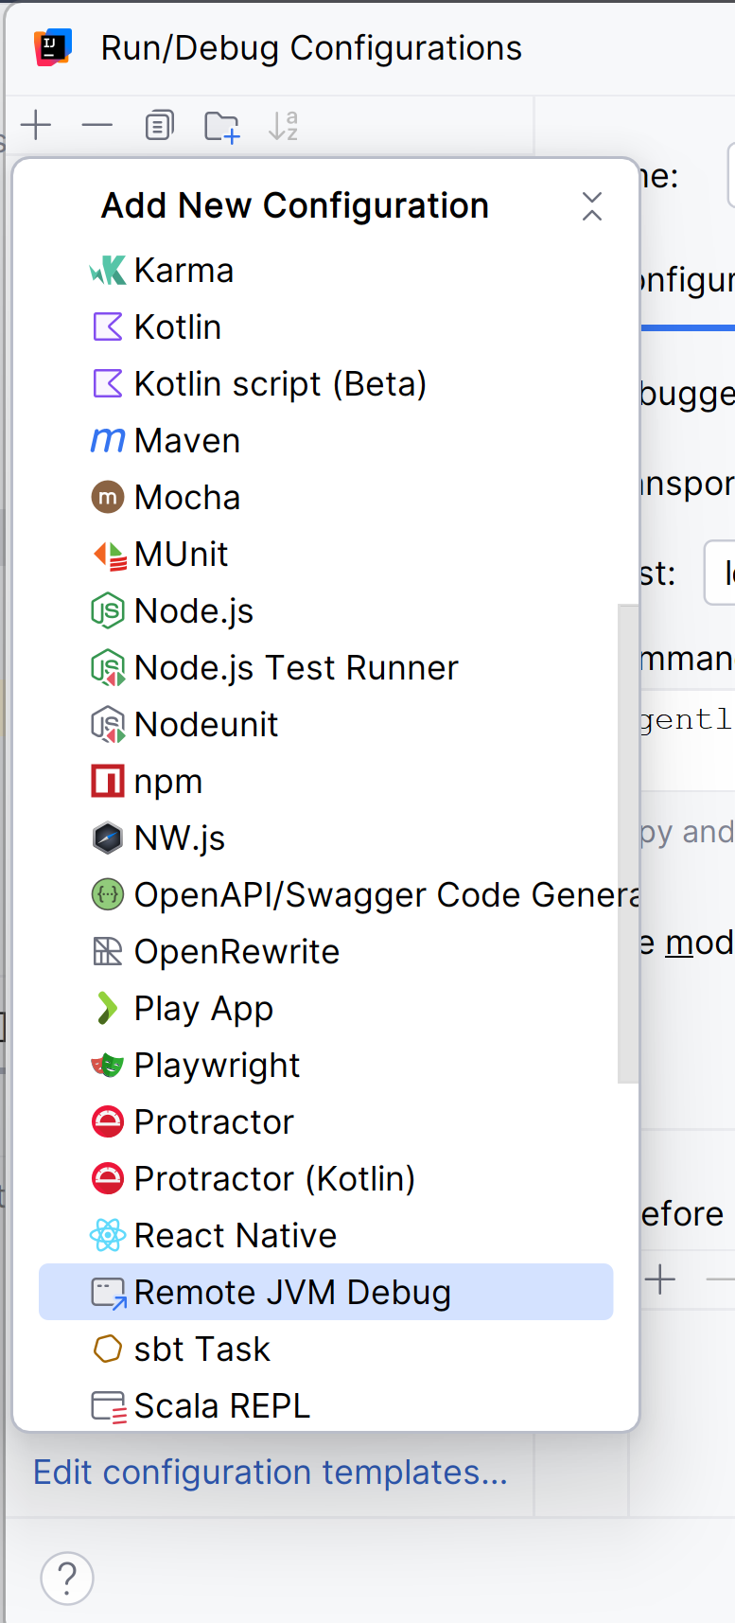
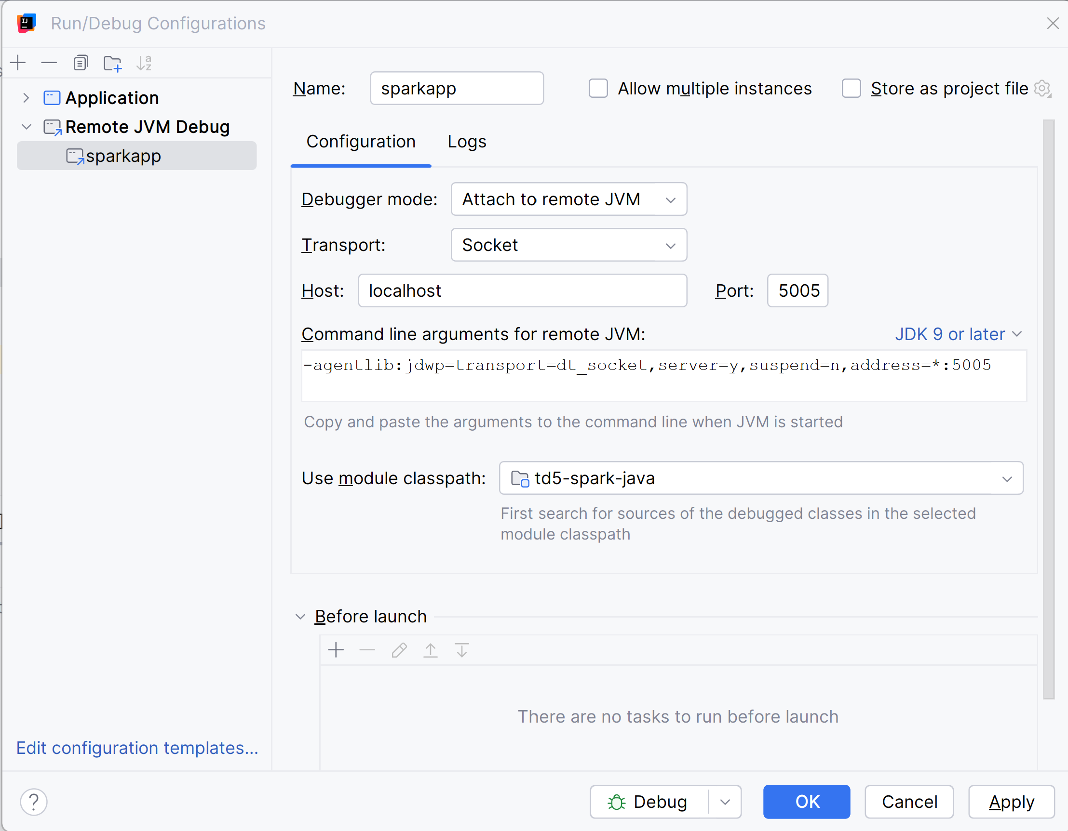
Attaching Remote JVM Debugger

Slide 55
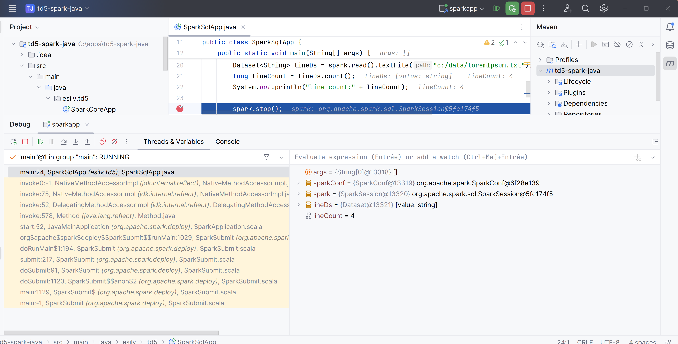
See main class is not "esilv.td5.SparkSqlApp" but "org.apache.spark.deploy.SparkSubmit"

Slide 56
Spark SQL <-> Java with UDF Function

Slide 57
Exercise 2
The city name "Laval" written in reversed order is still "laval"
(ignoring case) This is a palindrome How many French cities are like this?

Slide 58
Hint : Use Dataset .map() and .filter() and String .toLowerCase() and .reverse()
If you forgot to do ".toLowerCase()" => there would be only 1 City, named "Y"
in fact, there are 21
can you find them all ?
afa
callac
cazac
erre
esse
laval
noyon
...

Slide 59
Exercise Setup
spark.sql("SELECT DISTINCT commune_nom, commune_insee FROM db1.addr")
.write.format("parquet").saveAsTable("db1.city")
spark.sql("select count(*) from db1.city").show() // => 34986
spark.sql("SELECT distinct commune_nom FROM db1.city")
.write.format("parquet").saveAsTable("db1.city_name")
spark.sql("select count(*) from city_name").show() // => 32735 ... almost 2000 duplicate city name in France !
OK, this is NOT BigData... we could "collectAsList()" and perform directly in scala

Slide 60
HINT
val palindromes = spark.sql("select commune_nom from db1.city")
.map(row => row.getString(0).toLowerCase())
.filter(x => x.reverse == x)
palindromes.count()
palindromes.show()

Slide 61
"String.reverse()" is Java built-in => redo with SQL built-in
Reapeat exercise in SQL (not using Spark Dataset API),
spark.sql("""
select commune_nom from db1.city
WHERE reverse(lower(commune_nom))=lower(commune_nom)
""").show()
Too easy again...

Slide 62
Using SQL and User-Defined Function "UDF"
.. Reapeat without using built-in Sql "REVERSE",
by defining your own UDF function "isPalindrome(text)"
SELECT * FROM db1.city
WHERE isPalindrome(lower(commune_nom))
complete code: spark.udf.register("isPalindrome", (s: String) => ....)

Slide 63
HINT
spark.udf.register("isPalindrome", (s: String) => s != null && s == s.reverse)
spark.sql("select commune_nom from db1.city WHERE isPalindrome(lower(commune_nom))").show()

Slide 64
Exercise
City names
"Sancerre" and "Nanterre"
have only 2 letters difference.
The postman could do mistakes...
How many cities are error-prone like this.
What is the city with the most numerous errors, for 1 letter of difference?

Slide 65
What is an "Edit Distance" ?
how many letters differ between "paris" and "parés"
=> Response : 1 (change of 1 letter "i" -> "é")
how many letters differ between "paris" and "pris"
=> Response : 1 (deletion of 1 letter "a")
Calculating "changed" letters only is trivial (but not in SQL).
How do you compute efficiently distances for "deletion" + "change" + "insertion" ?
... even in Java, it need special algorithm

Slide 66
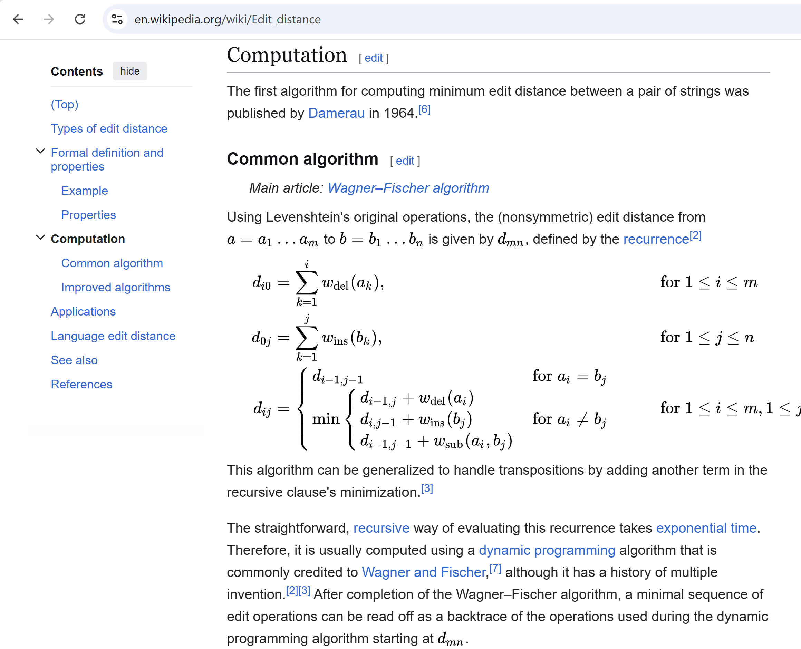
Edit Distance with Dynamic Programming Algorithm

Slide 67
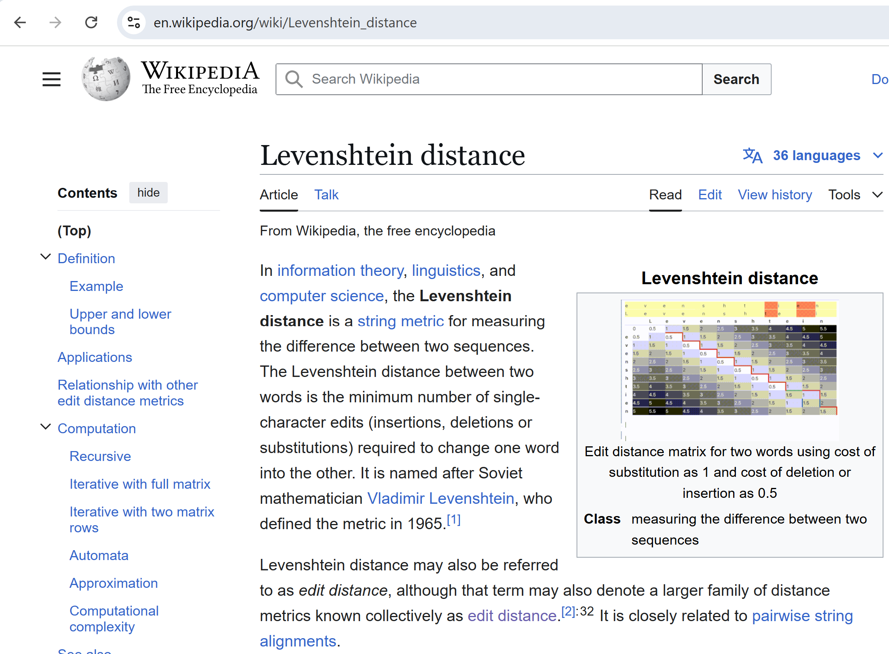
Levenstein Distance

Slide 68
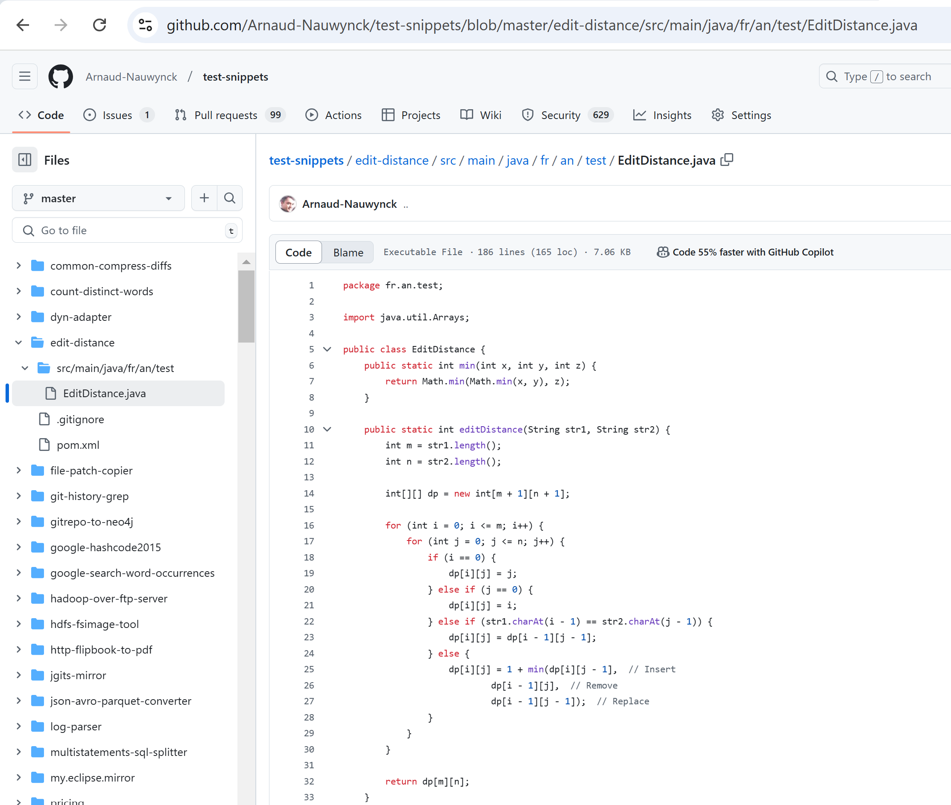
EditDistance.java Implementation
source code (extracted from apache Commons Lang)
https://github.com/Arnaud-Nauwynck/test-snippets/blob/master/edit-distance/src/main/java/fr/an/test/EditDistance.java

Slide 69
Download jar (or rebuild "mvn package") + relaunch "spark-shell --jars your.jar"
spark-shell --driver-memory=8g --jars edit-distance.jar
or using full path
spark-shell --driver-memory=8g --jars file:///c:/apps/spark/edit-distance.jar
or simply copy file in ${SPARK_HOME}/jars/

Slide 70
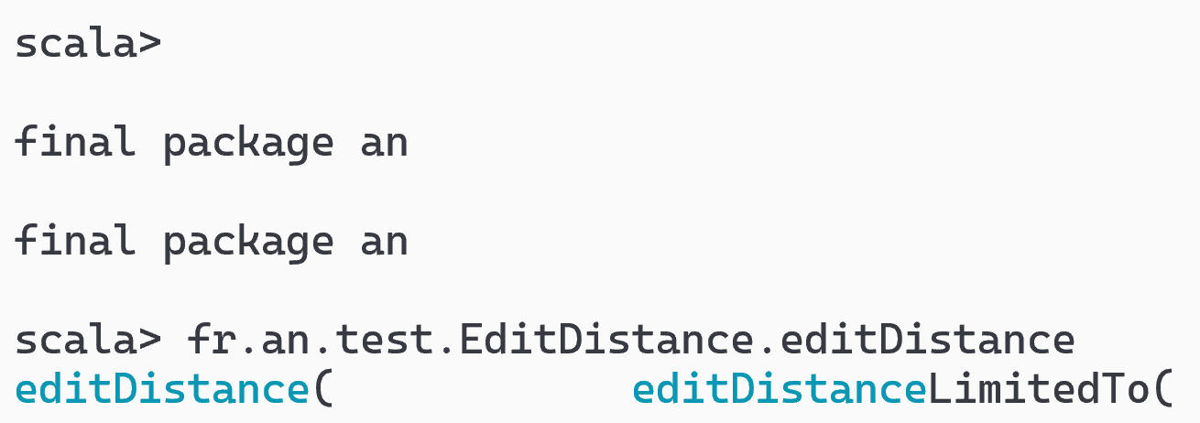
Test Class is available in spark-shell scala>
Test in interactive shell that you have <TAB><TAB> Auto-completion
on "fr."
=> autocomplete to package "fr.an"
..
<TAB><TAB>
=> autocomplete to package "fr.an" ... then to class then to methods

Slide 71
Test Java methods (in scala)
fr.an.test.EditDistance.editDistance("paris", "pris")
// 1
// the variant "LimitedTo" stop computing for a given threshold, and return it as maximum diff
fr.an.test.EditDistance.editDistanceLimitedTo("paris", "pris", 5)
// 1
fr.an.test.EditDistance.editDistanceLimitedTo("paris", "prisées", 10)
// 4
fr.an.test.EditDistance.editDistanceLimitedTo("paris", "prisées", 3)
// 3 ... real diff was 4, but result limited to 3

Slide 72
Define UDF functions, Test in SQL
spark.udf.register("editDistance", udf( (str1: String, str2: String) => fr.an.test.EditDistance.editDistance(str1, str2 )));
spark.udf.register("editDistanceLimitedTo", udf( (str1: String, str2: String, m: Int) => fr.an.test.EditDistance.editDistanceLimitedTo(str1, str2, m)));
spark.sql("select editDistance('paris', 'pris')").show()
// 1
spark.sql("select editDistanceLimitedTo('paris', 'prisées', 3)").show()
// 3

Slide 73
callUDF() : call using Dataset Column API
val ds2 = ds.withColumn("dist_to_paris", callUDF("editDistance", lit("paris"), $"commune_nom") )
scala> ds2.show(5, false)
+------------------------+-----------------+
|commune_nom |dist_to_paris|
+------------------------+-----------------+
|Frans |4 |
|Coulonges-Cohan|14 |
|Grisolles |7 |
|Leury |5 |
|Deux-Chaises |10 |
+-----------------------+-----------------+
NOTE: calling explicitly in java
import org.apache.spark.sql.functions;
functions.callUDF("editDistance", functions.lit("paris"), col(commune_nom"))

Slide 74
cross join city1, city2 restrict with city1 < city2 eval d=distanceLimitedTo (.. 2) filter d<2
what is the algorithm complexity for N cities ?
spark.sql("select count(*) from db1.city").show() // 34986
using distinct name? 32735
34986 * 34986 / 2 = 612010098 = 612 Millions of city pairs to eval
and each computation, this may take long => so restrict to maximum 2 differences,
we will consider only diff=1 (<2)
( On Intel Core i7, it takes ~3 minutes )

Slide 75
Dataset Cross Cities with distance<2
val crossDs = spark.sql("""
SELECT distinct c1.commune_nom as c1_nom, c2.commune_nom as c2_nom
FROM db1.city_name c1
CROSS JOIN db1.city_name c2
WHERE c1.commune_nom < c2.commune_nom
""")
// repartition does NOT work here !
val crossDist = crossDs.repartition(16).withColumn("d", callUDF("editDistanceLimitedTo", crossDs("c1_nom"), crossDs("c2_nom"), lit(2))).filter($"d" < 2).cache()
crossDist.show(10, false) // <=== take long ~3 minutes !!!

Slide 76
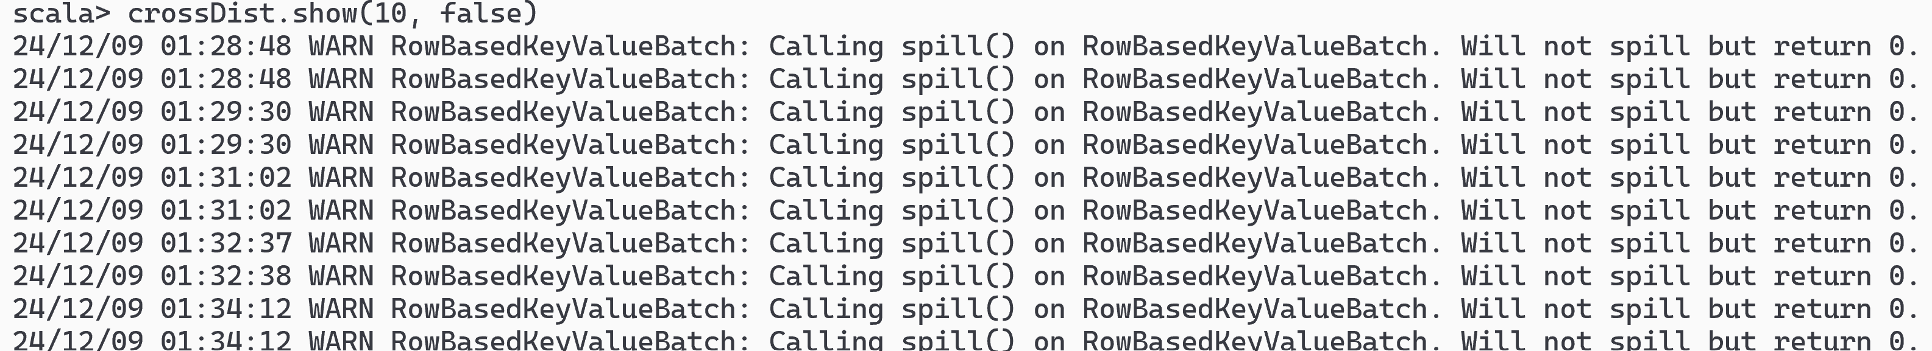
Spill to Disk ... use --driver-memory=8g

Slide 77


.repartition(16) IGNORED !! => only using 1 CPU
push down
in broadcast join !
or even AQE
after

Slide 78
Cross City Pairs with Distance=1
scala> crossDist.show(10, false)
+---------------------------+---------------------------+---+
|c1_nom |c2_nom |d |
+---------------------------+---------------------------+---+
|Auge |Augy |1 |
|Many |Mary |1 |
|Lunan |Lunay |1 |
|Caunay |Launay |1 |
|Ballons |Baâlons |1 |
|Sassay |Sassy |1 |
|Marseille 2e Arrondissement|Marseille 9e Arrondissement|1 |
|Saisy |Saizy |1 |
|Amécourt |Imécourt |1 |
|Audon |Auxon |1 |
+---------------------------+---------------------------+---+
only showing top 10 rows
scala> crossDist.count()
val res4: Long = 9808

Slide 79
Find the Cities having the most similarities Can you find this ?
+---------------------+-------+
| c1_nom|count|
+---------------------+-------+
| Bailly | 13|
| Cailly | 12|
| Bessac | 10|
| Aron | 10|
| Bay | 10|
|Paris 10e Arro...| 10|
| Coux | 10|
| Maray | 10|
| Aigny | 10|
| Lailly | 10|
+---------------------+-------+
only showing top 10 rows

Slide 80
HINT
crossDist.groupBy("c1_nom").count().orderBy(desc("count")).show(10)
WARNING: when forgetting to use "distinct commune_nom"
(cities with same name, but different zipCode)
+-------------+-----+
| c1_nom|count|
+-------------+-----+
| Caumont| 56|
| Ferrières| 55|
| Mons| 49|
| Celles| 44|
| Brion| 42|
| Bailly| 40|
| Bannes| 40|
| Fons| 39|
| Marsac| 36|
| Salles| 35|
+-------------+-----+
only showing top 10 rows

Slide 81
13 Cities with Distance=1 to "Bailly"
spark.sql("""select c1_nom, d from (select c1.commune_nom as c1_nom, editDistanceLimitedTo(c1.commune_nom, "Bailly", 2) as d from db1.city_name c1 where c1.commune_nom <> "Bailly") where d < 2 ORDER BY d """).show(50);
+-------+---+
| c1_nom| d|
+-------+---+
| Vailly| 1|
| Nailly| 1|
| Sailly| 1|
| Jailly| 1|
| Mailly| 1|
| Lailly| 1|
| Cailly| 1|
| Billy| 1|
| Pailly| 1|
| Tailly| 1|
| Wailly| 1|
| Failly| 1|
|Batilly| 1|
|Bacilly| 1|
+-------+---+

Slide 82
12 Cities with Distance=1 to "Bessac"
spark.sql("""select c1_nom, d from (select c1.commune_nom as c1_nom, editDistanceLimitedTo(c1.commune_nom, "Bessac", 2) as d from db1.city_name c1 where c1.commune_nom <> "Bessac") where d < 2 ORDER BY d """).show(50);
+-------+---+
| c1_nom| d|
+-------+---+
| Pessac| 1|
| Bessay| 1|
| Messac| 1|
| Bessan| 1|
| Bassac| 1|
|Beyssac| 1|
|Blessac| 1|
| Cessac| 1|
| Bessas| 1|
| Lessac| 1|
| Bussac| 1|
+-------+---+

Slide 83
Exercise : UDAF (!= UDF) User-Defined Aggregate Function

Slide 84
Example of "Aggregate" function : min(), max(), count(), sum(), avg(), stddev(), ...
They are not really "function", but more "statefull accumulator"

Slide 85
Exercise : find the most "round" / "elongated" shape cities
define a UDAF for accumulating points coordinate statistics ( sum x^2, sum x*y, sum y^2) => internally add to current covariance Matrix state
=> on finish, decompose Matrix with 2 eigen vectors
=> return ..

Slide 86

see Doc UDAF
https://spark.apache.org/docs/3.5.3/sql-ref-functions-udf-aggregate.html

Slide 87
Aggregator<IN,BUFFER,OUT>
IN => named_struct "Point"
BUFFER => internal sums + number of point
OUT => named_struct for matrix
exercise left to students ...

Slide 88
Exercise : draw a MindMap of this Hands-on session

Slide 89
MindMap
spark-submit --class {} jar {}
mvn package
error on windows AppData/Temp/*.jar file locked
Debug remote JVM (port 5005)
merge
Java IDE
IDEA Intellij
<dependency>
<groupId>org.apache.spark</groupId>
<artifactId>spark-sql_2.13</artifactId>
</dependency>
add
spark-submit
result
callUDF()
init
pom.xml
sample UDF
levenstein
editDistance()
UDAF
JVM (>=11) args need --open-module
UDF
Spark - Java
SparkConf
spark.udf().register()
SparkContext
using spark-hive
using spark-core
.getOrCreate(conf)
workingDir
spark-warehouse
RDD
using spark-sql
DataFrame
Dataset<Row>
SparkSession
SparkSession.builder()
.config(sparkConf)
.getOrCreate(conf)
SparkSession.builder()
. enableHiveSupport()
Encoders
Dataset
.toDF()
.bean( .class)
.STRING()
.as(encoder)

Slide 90
Questions ?

